Slide 1



tranSMART Platform Demo
Kai Sun
January, 2015
14/01/2015
Kai Sun (kai.sun09@imperial.ac.uk)
1

Slide 2
U-BIOPRED tranSMART Training
How to…
Download an entire dataset
Download selected variables
Locate variables
Compare two groups
Produce “omics” signatures
Produce “omics” signatures for a KEGG¹ pathway
Compare the expression of a molecule in an “omic” dataset
Compare two variables
Report bugs
1. http://www.genome.jp/kegg/pathway.html
14/01/2015
Kai Sun (kai.sun09@imperial.ac.uk)
2

Slide 3
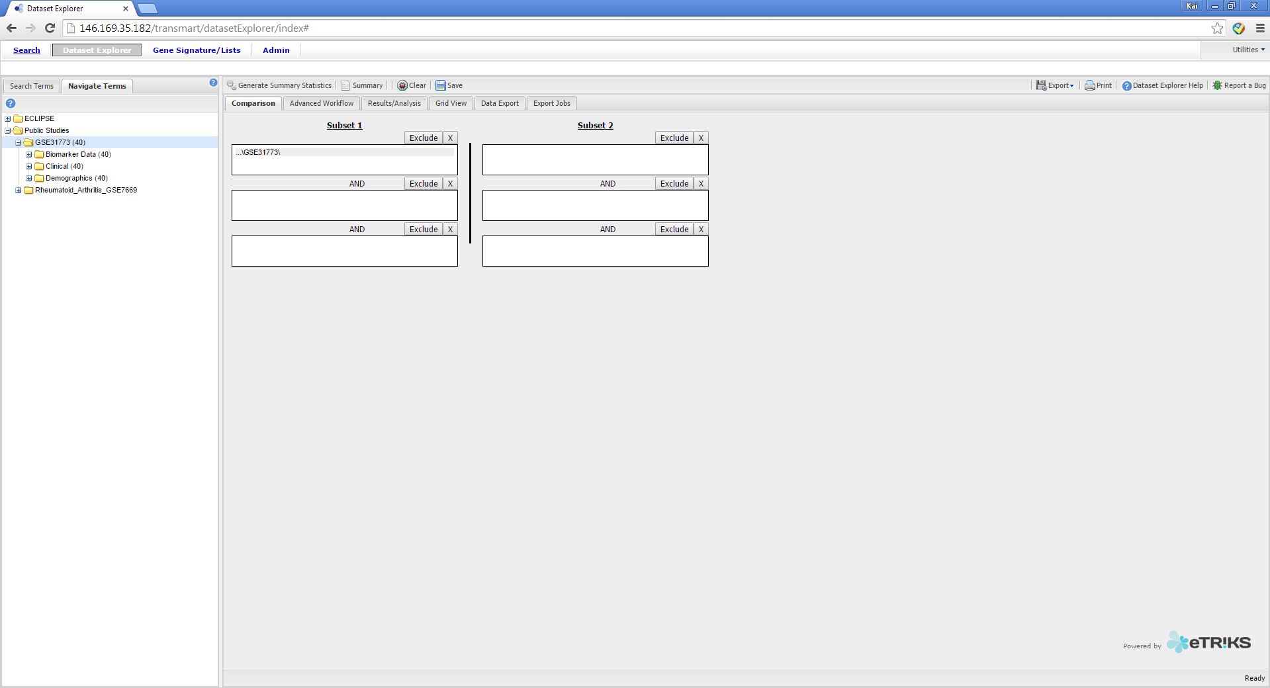
U-BIOPRED tranSMART Training
How to download an entire dataset
Step 1. Drag and Drop the study you wish to download
into Subset 1 box
Step 2. Left Click the Data Export Tab
14/01/2015
Kai Sun (kai.sun09@imperial.ac.uk)
3

Slide 4
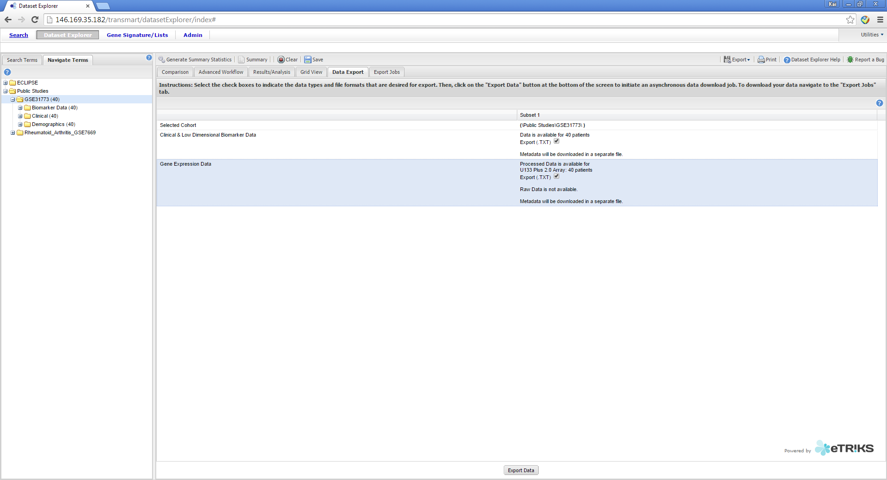
U-BIOPRED tranSMART Training
How to download an entire dataset
Step 3. Select the datasets you wish to download by ticking the boxes
Step 4. Left Click the Export Data button
14/01/2015
Kai Sun (kai.sun09@imperial.ac.uk)
4

Slide 5
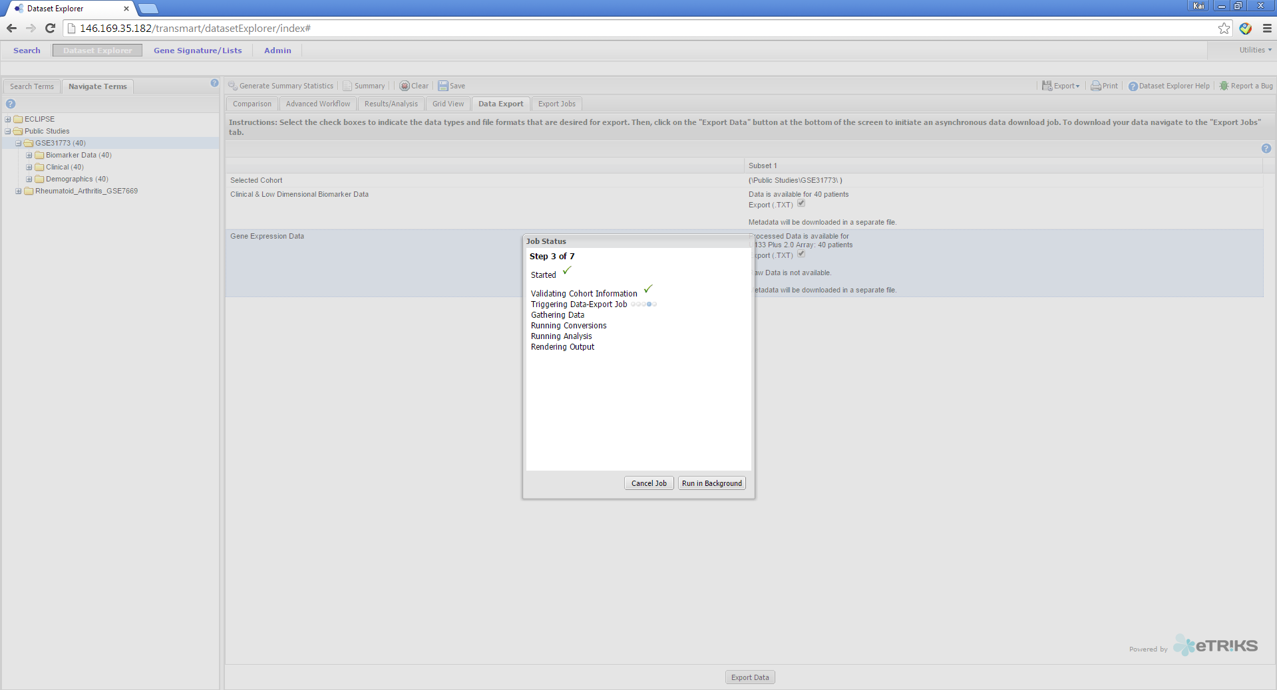
U-BIOPRED tranSMART Training
How to download an entire dataset
Step 5. When downloading large datasets click
run in background
Step 6. Left Click on the Export Jobs tab
14/01/2015
Kai Sun (kai.sun09@imperial.ac.uk)
5

Slide 6
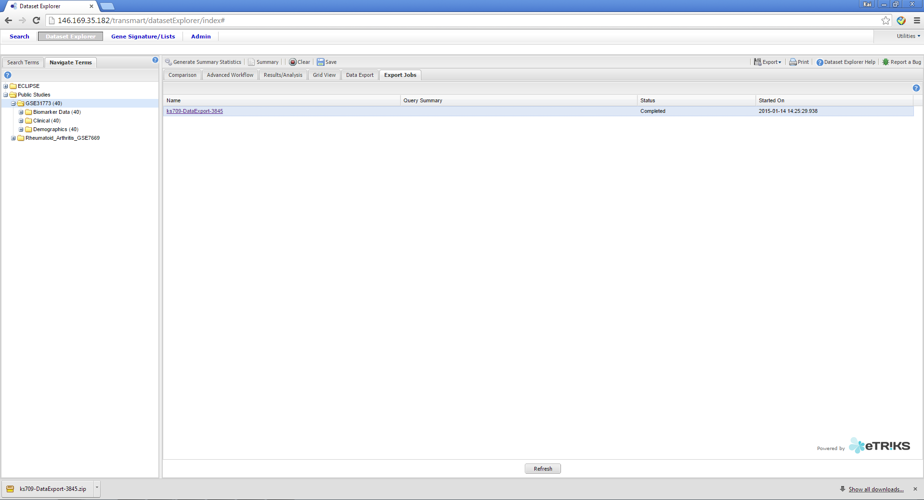
U-BIOPRED tranSMART Training
How to download an entire dataset
Step 8. Monitor your export progress intermittently
Pressing refresh
Step 9. Once the status changes to “Completed”
Left click on the name and download the files to your
computer
14/01/2015
Kai Sun (kai.sun09@imperial.ac.uk)
6

Slide 7
U-BIOPRED tranSMART Training
How to…
Download an entire dataset
Download selected variables
Locate variables
Compare two groups
Produce “omics” signatures
Produce “omics” signatures for a KEGG¹ pathway
Compare the expression of a molecule in an “omic” dataset
Compare two variables
Report bugs
1. http://www.genome.jp/kegg/pathway.html
14/01/2015
Kai Sun (kai.sun09@imperial.ac.uk)
7

Slide 8
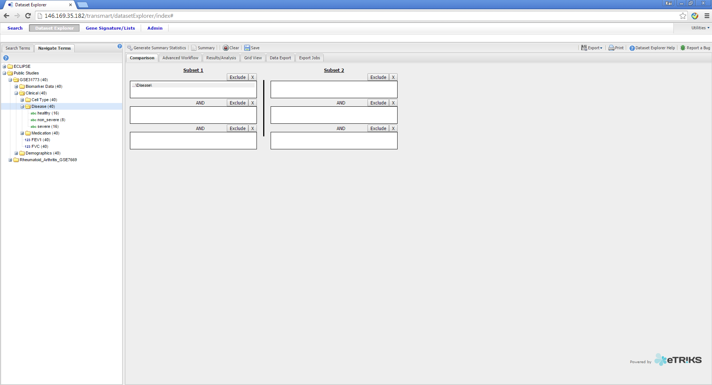
U-BIOPRED tranSMART Training
How to download selected variables
Step 1. Drag and Drop the “Disease” folder into
the Subset 1 box
Step 2. Left click on Generate Summary Statistics
14/01/2015
Kai Sun (kai.sun09@imperial.ac.uk)
8

Slide 9
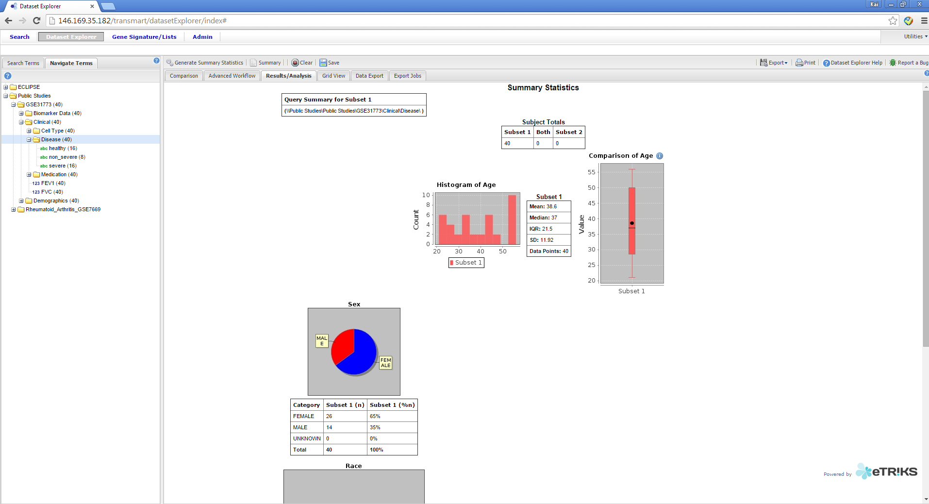
U-BIOPRED tranSMART Training
How to download selected variables
Step 3. Left Click on the Grid View tab
14/01/2015
Kai Sun (kai.sun09@imperial.ac.uk)
9

Slide 10
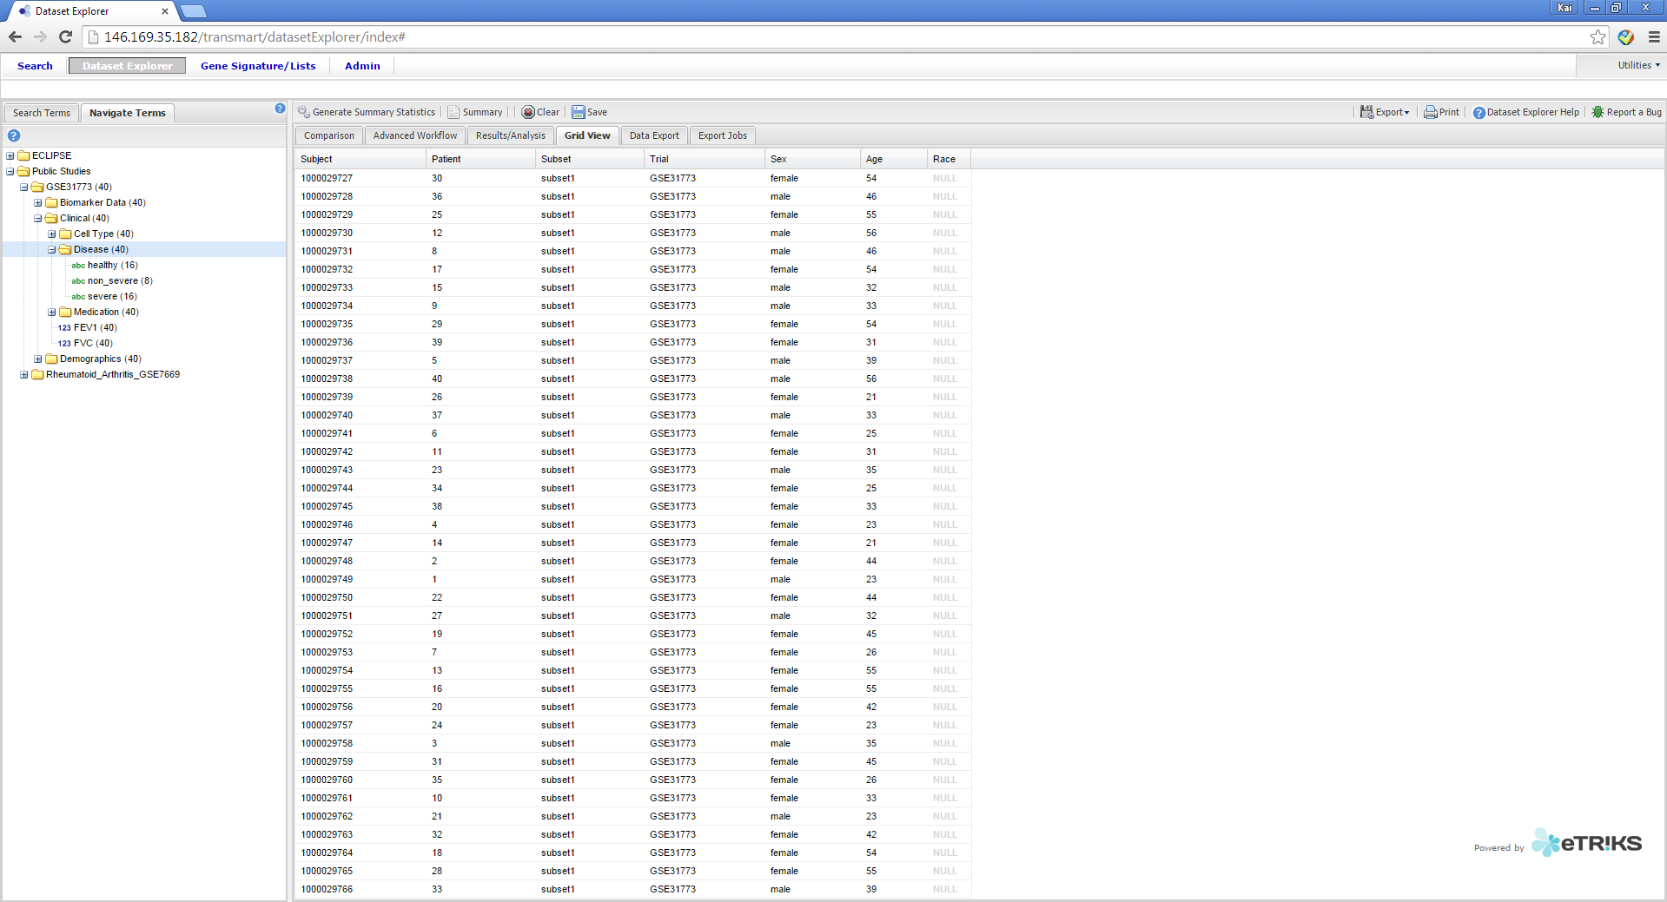
U-BIOPRED tranSMART Training
How to download selected variables
Step 4. Navigate to the variables you would like to download in the Navigate Terms Tab
Step 5. Drag and Drop the variables to the Grid View Tab
14/01/2015
Kai Sun (kai.sun09@imperial.ac.uk)
10

Slide 11
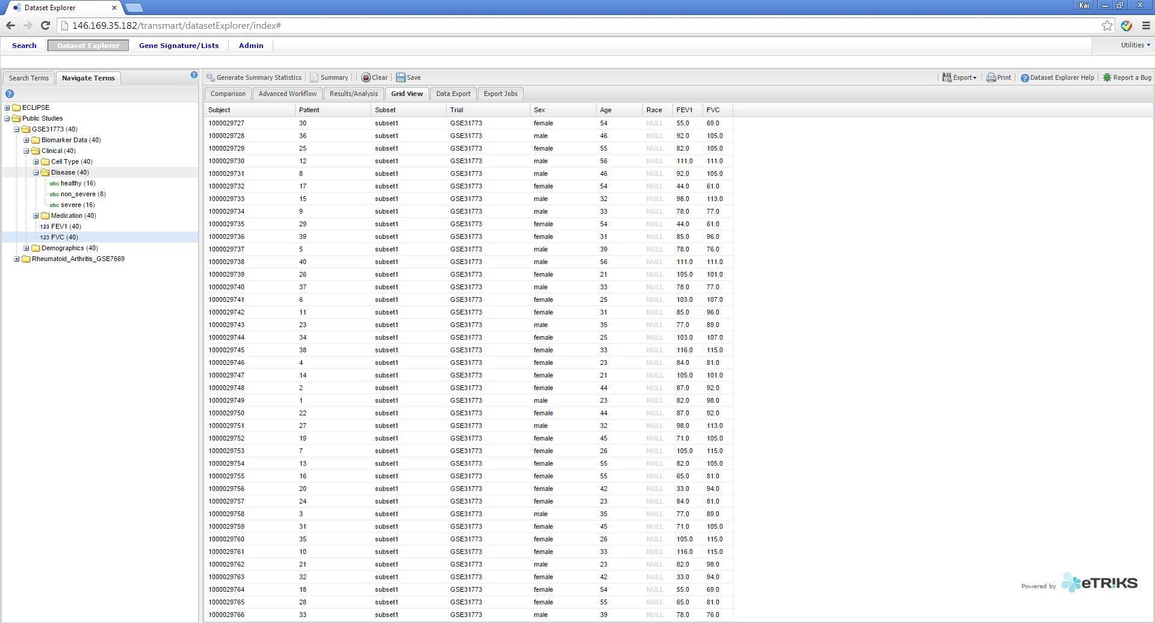
U-BIOPRED tranSMART Training
How to download selected variables
Step 6. Left Click on the Export button
14/01/2015
Kai Sun (kai.sun09@imperial.ac.uk)
11

Slide 12
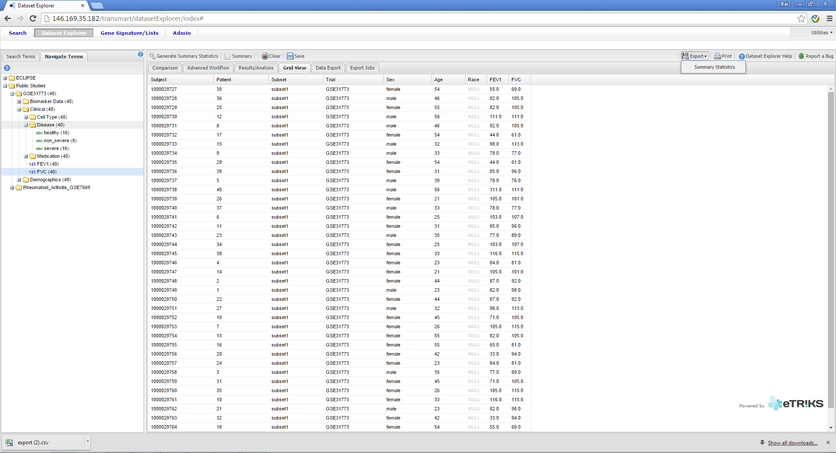
U-BIOPRED tranSMART Training
How to download selected variables
Step 7. Left Click on the Summary Statistics button, then download the data on your computer
19/01/2015
Kai Sun (kai.sun09@imperial.ac.uk)
12

Slide 13
U-BIOPRED tranSMART Training
How to…
Download an entire dataset
Download selected variables
Locate variables
Compare two groups
Produce “omics” signatures
Produce “omics” signatures for a KEGG¹ pathway
Compare the expression of a molecule in an “omic” dataset
Compare two variables
Report bugs
1. http://www.genome.jp/kegg/pathway.html
14/01/2015
Kai Sun (kai.sun09@imperial.ac.uk)
13

Slide 14
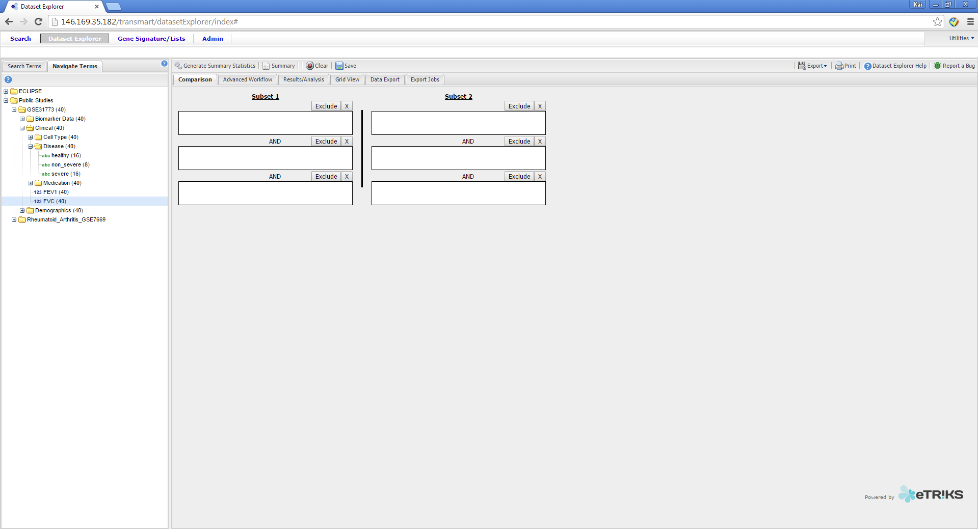
U-BIOPRED tranSMART Training
How to locate variables
Step 1. Left Click the Search Terms tab
14/01/2015
Kai Sun (kai.sun09@imperial.ac.uk)
14

Slide 15
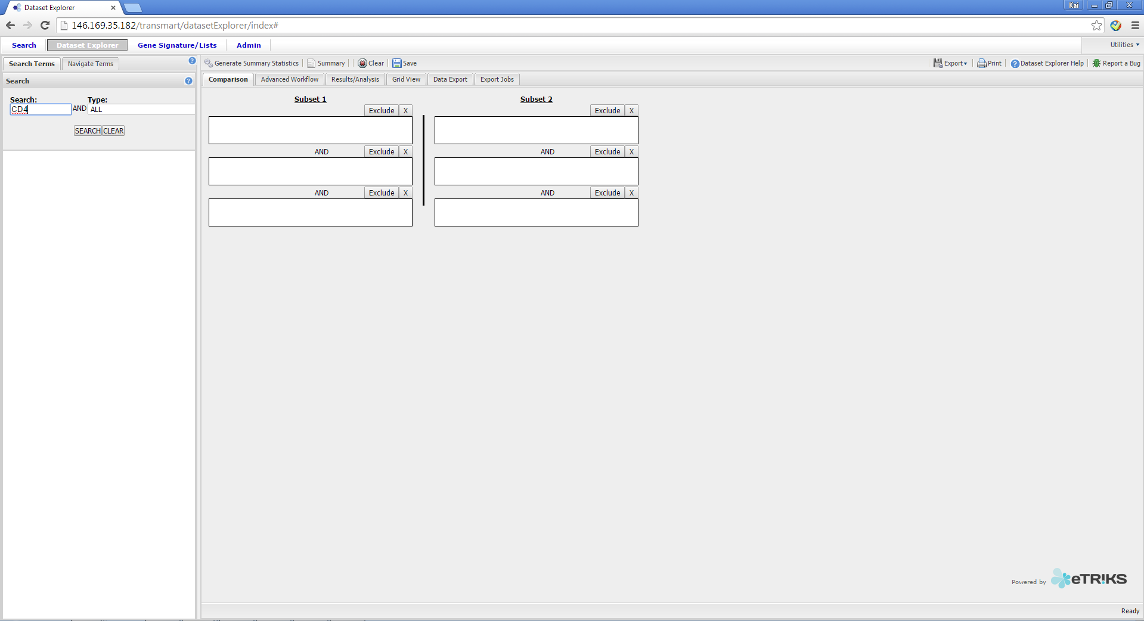
U-BIOPRED tranSMART Training
How to locate variables
Step 2. Enter the term you are looking for in the Search Box, and Choose the type of the term
Step 3. Left Click the SEARCH button
14/01/2015
Kai Sun (kai.sun09@imperial.ac.uk)
15

Slide 16
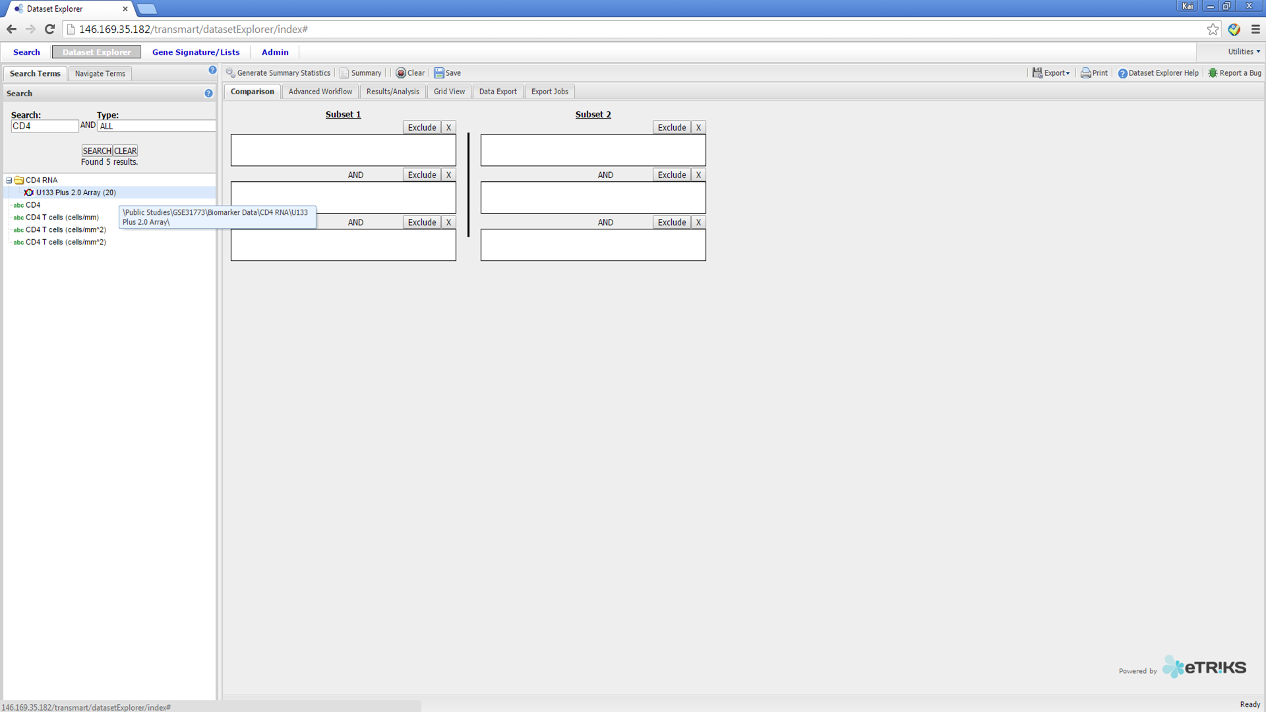
U-BIOPRED tranSMART Training
How to locate variables
Step 4. Hover your mouse over the results, and see the location of the variable
14/01/2015
Kai Sun (kai.sun09@imperial.ac.uk)
16

Slide 17
U-BIOPRED tranSMART Training
How to…
Download an entire dataset
Download selected variables
Locate variables
Compare two groups
Produce “omics” signatures
Produce “omics” signatures for a KEGG¹ pathway
Compare the expression of a molecule in an “omic” dataset
Compare two variables
Report bugs
1. http://www.genome.jp/kegg/pathway.html
14/01/2015
Kai Sun (kai.sun09@imperial.ac.uk)
17

Slide 18
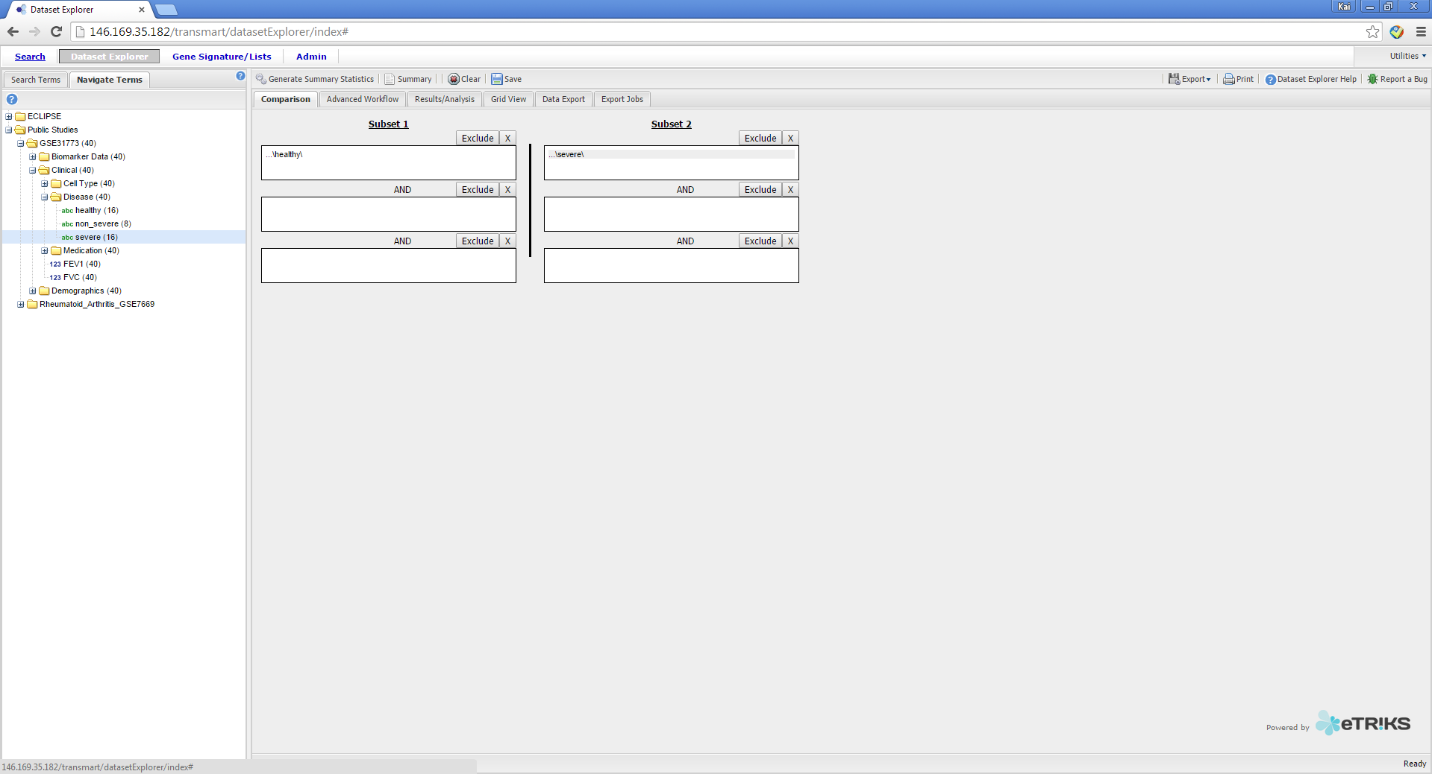
U-BIOPRED tranSMART Training
How to compare two groups
Step 1. Drag and drop the two groups you want to
Compare into Subset 1 and Subset 2 boxes
Step 2. Left Click Generate Summary Statistics
14/01/2015
Kai Sun (kai.sun09@imperial.ac.uk)
18

Slide 19
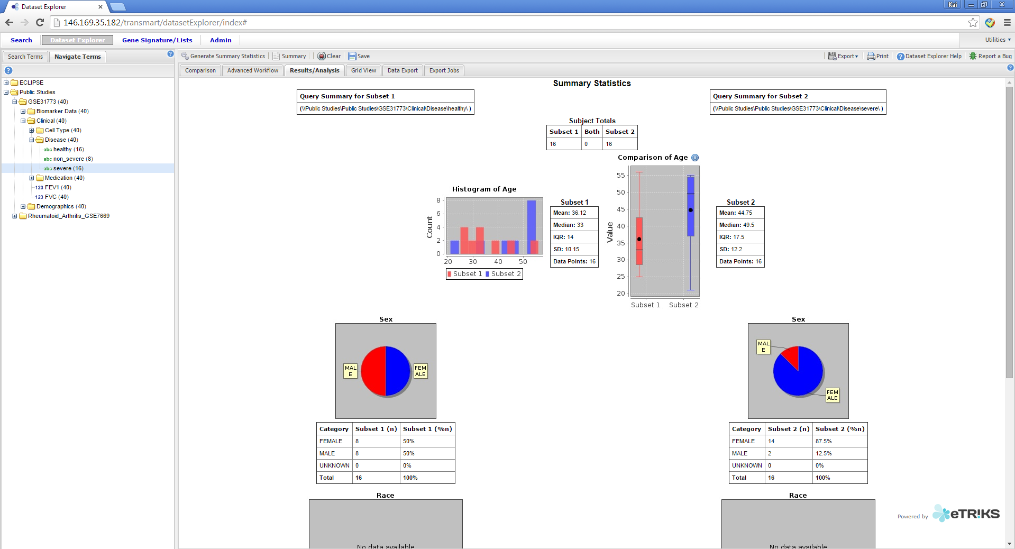
U-BIOPRED tranSMART Training
How to compare two groups
Step 3. Drag and drop the variable you wish to analyse into the window
14/01/2015
Kai Sun (kai.sun09@imperial.ac.uk)
19

Slide 20
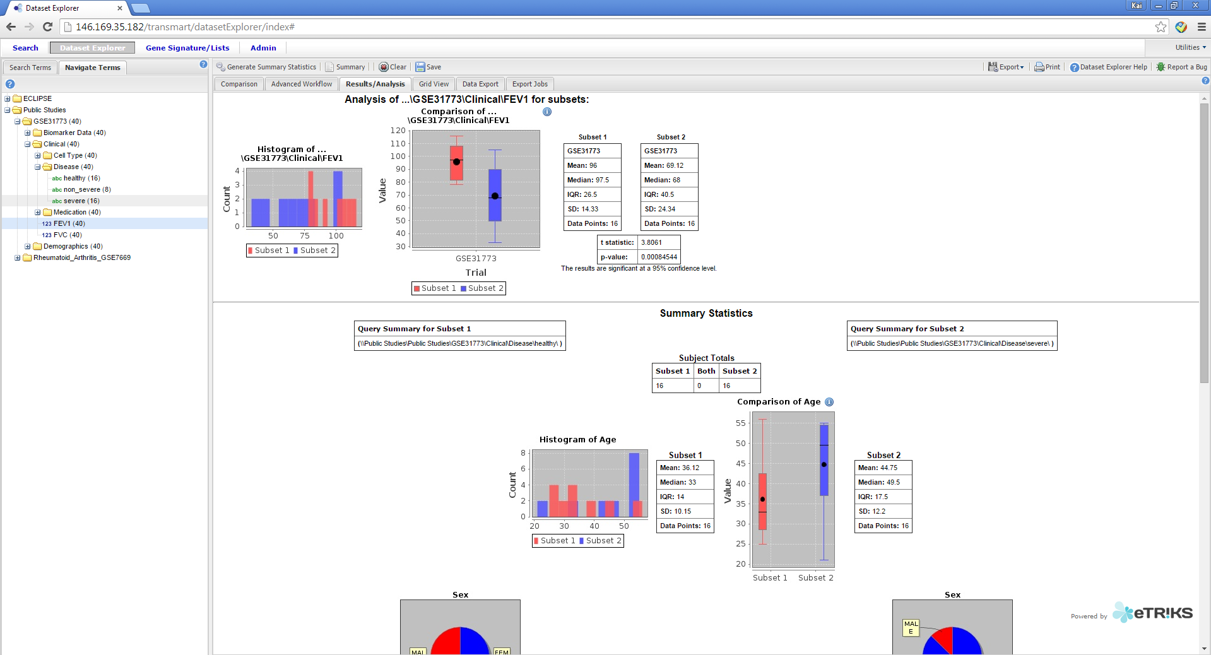
U-BIOPRED tranSMART Training
How to compare two groups
Step 4. For numerical variables (denoted by the “123” prefix) you will be provided with the comparison statistics (t-test)
14/01/2015
Kai Sun (kai.sun09@imperial.ac.uk)
20

Slide 21
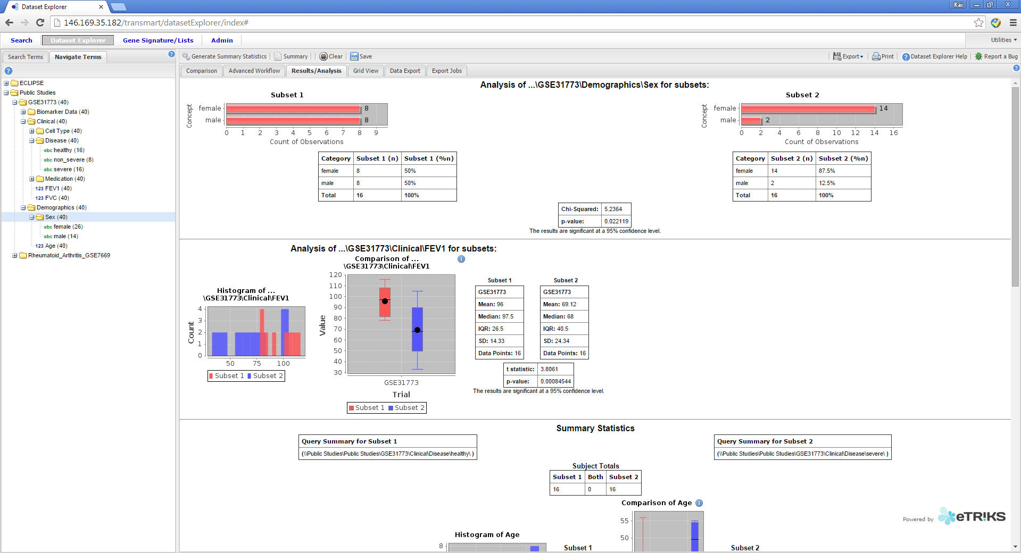
U-BIOPRED tranSMART Training
How to compare two groups
Step 5. For categorical variables (denoted by the “abc” prefix) you will be provided with the comparison statistics (chi square-test). Note that you can drag and drop as many variables as you wish to analyse consecutively.
14/01/2015
Kai Sun (kai.sun09@imperial.ac.uk)
21

Slide 22
U-BIOPRED tranSMART Training
How to…
Download an entire dataset
Download selected variables
Locate variables
Compare two groups
Produce “omics” signatures
Produce “omics” signatures for a KEGG¹ pathway
Compare the expression of a molecule in an “omic” dataset
Compare two variables
Report bugs
1. http://www.genome.jp/kegg/pathway.html
14/01/2015
Kai Sun (kai.sun09@imperial.ac.uk)
22

Slide 23
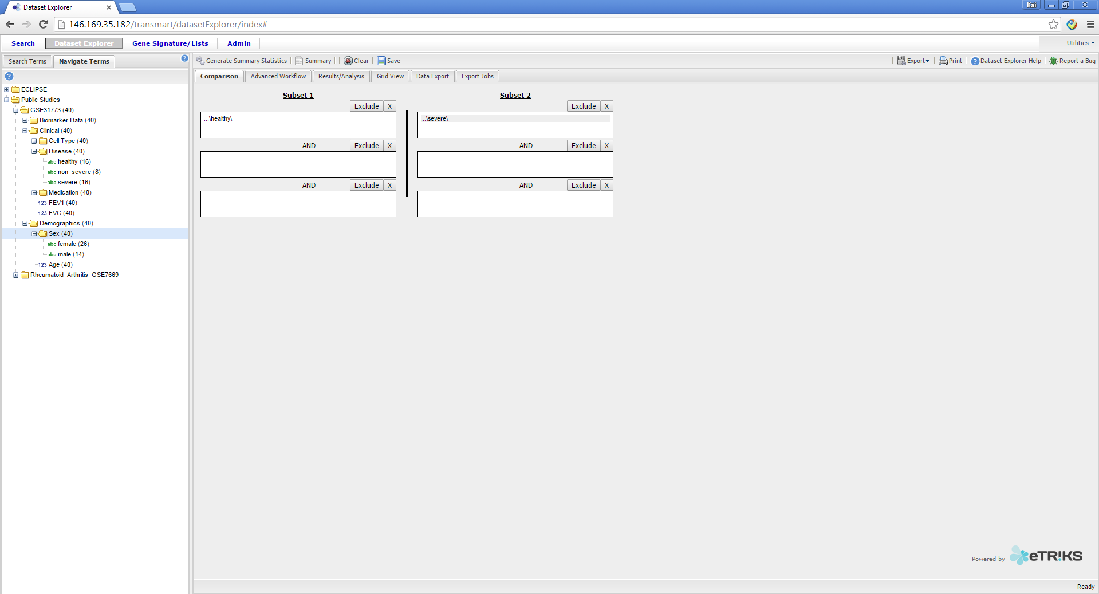
U-BIOPRED tranSMART Training
How to produce “omics” signatures
Step 1. Set your analysis groups
Step 2. Left Click “Advanced Workflow”
14/01/2015
Kai Sun (kai.sun09@imperial.ac.uk)
23

Slide 24
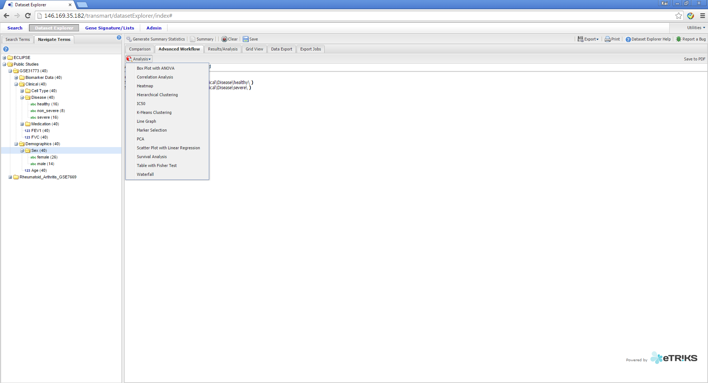
U-BIOPRED tranSMART Training
How to produce “omics” signatures
Step 3. Left Click “Analysis”
Step 4. Left Click “Marker Selection”
14/01/2015
Kai Sun (kai.sun09@imperial.ac.uk)
24

Slide 25
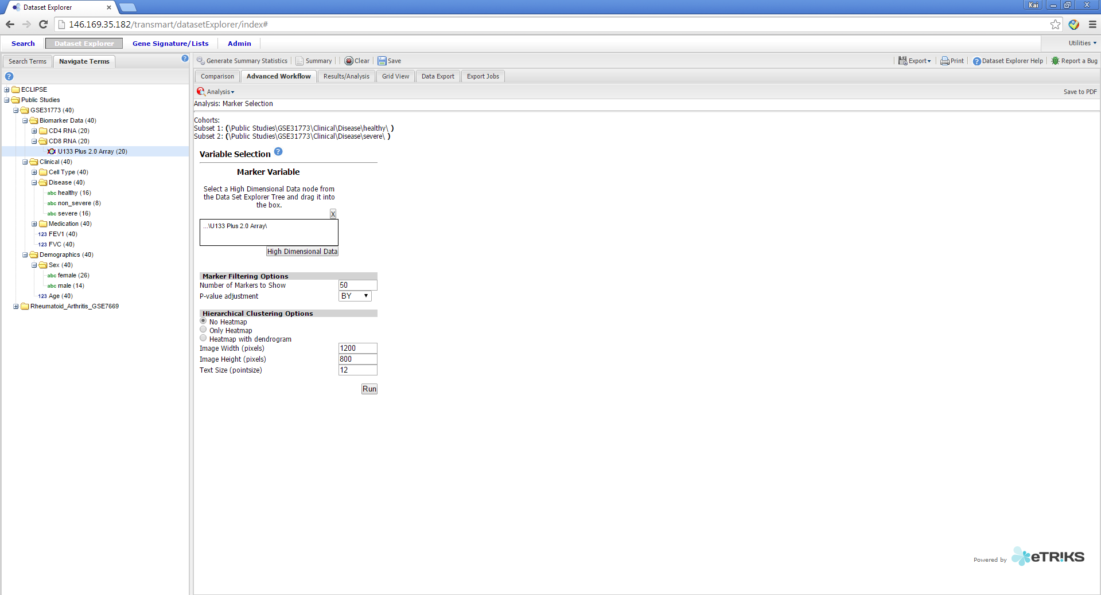
U-BIOPRED tranSMART Training
How to produce “omics” signatures
Step 5. Drag and Drop the Omics node (denoted by a “Double Helix Icon”) into the Marker Variable Box
Step 6. Left Click the “High Dimensional Button”
14/01/2015
Kai Sun (kai.sun09@imperial.ac.uk)
25

Slide 26
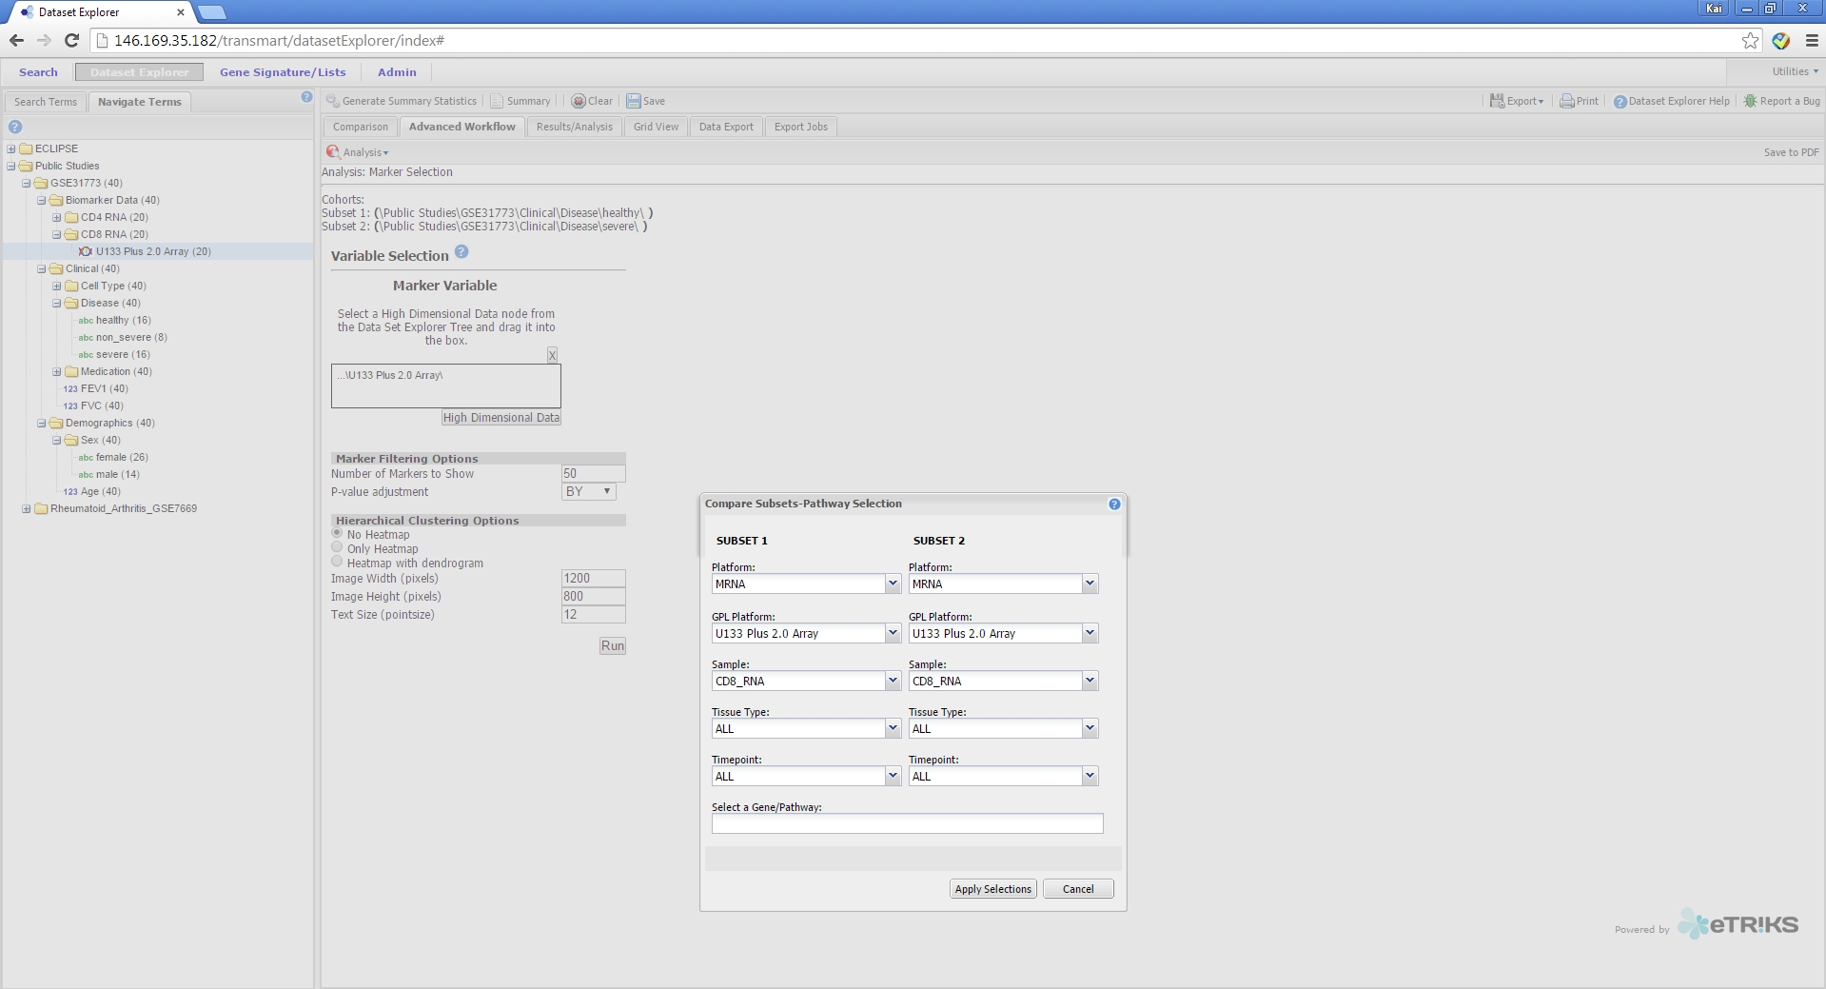
U-BIOPRED tranSMART Training
How to produce “omics” signatures
Step 7. Left Click “Apply selections”. Note that all analysis parameters are registered in the previous steps
14/01/2015
Kai Sun (kai.sun09@imperial.ac.uk)
26

Slide 27
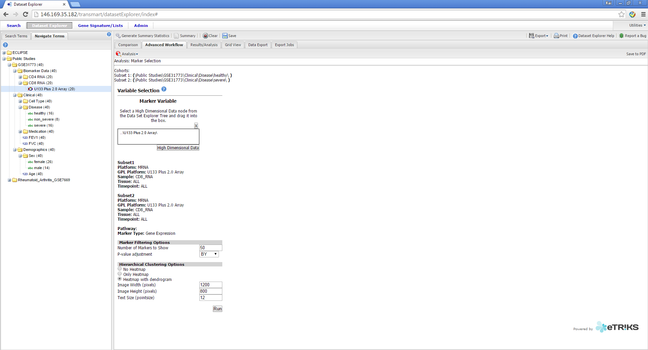
U-BIOPRED tranSMART Training
How to produce “omics” signatures
Step 8. Choose the number of markers to show
Step 9. Choose your p-value adjustment method:
BY: Benjamini-Yekutieli
BH: Benjamini-Hochberg (FDR)
Holm: Holm–Bonferroni
Step 10: Choose your Hierarchical Clustering Options
(Heatmap)
Step 11: Left Click “Run”
14/01/2015
Kai Sun (kai.sun09@imperial.ac.uk)
27

Slide 28
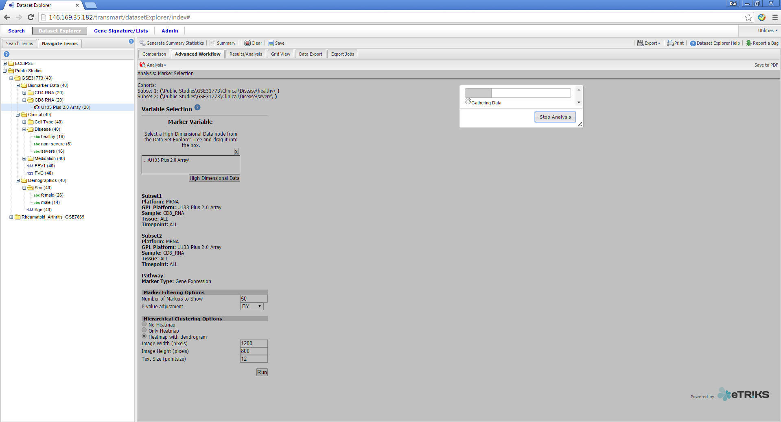
U-BIOPRED tranSMART Training
How to produce “omics” signatures
Step 11. Wait for the analysis to complete. Note that for a large number of patients there may be considerable wait.
Suggestion: Have a cup of coffee or tea…
14/01/2015
Kai Sun (kai.sun09@imperial.ac.uk)
28

Slide 29
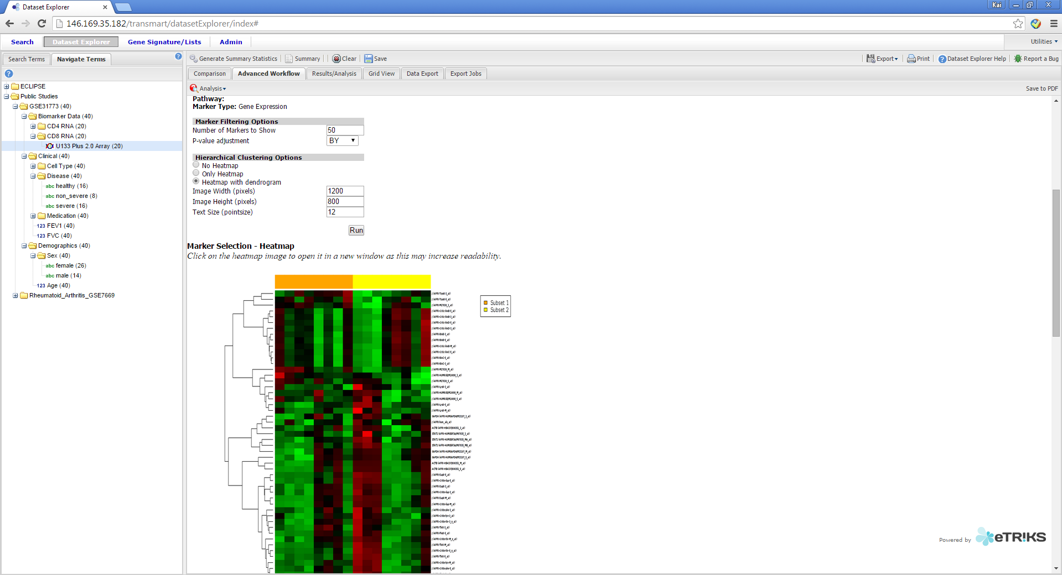
U-BIOPRED tranSMART Training
How to produce “omics” signatures
Step 12: Scroll down and view the clustering results
14/01/2015
Kai Sun (kai.sun09@imperial.ac.uk)
29

Slide 30
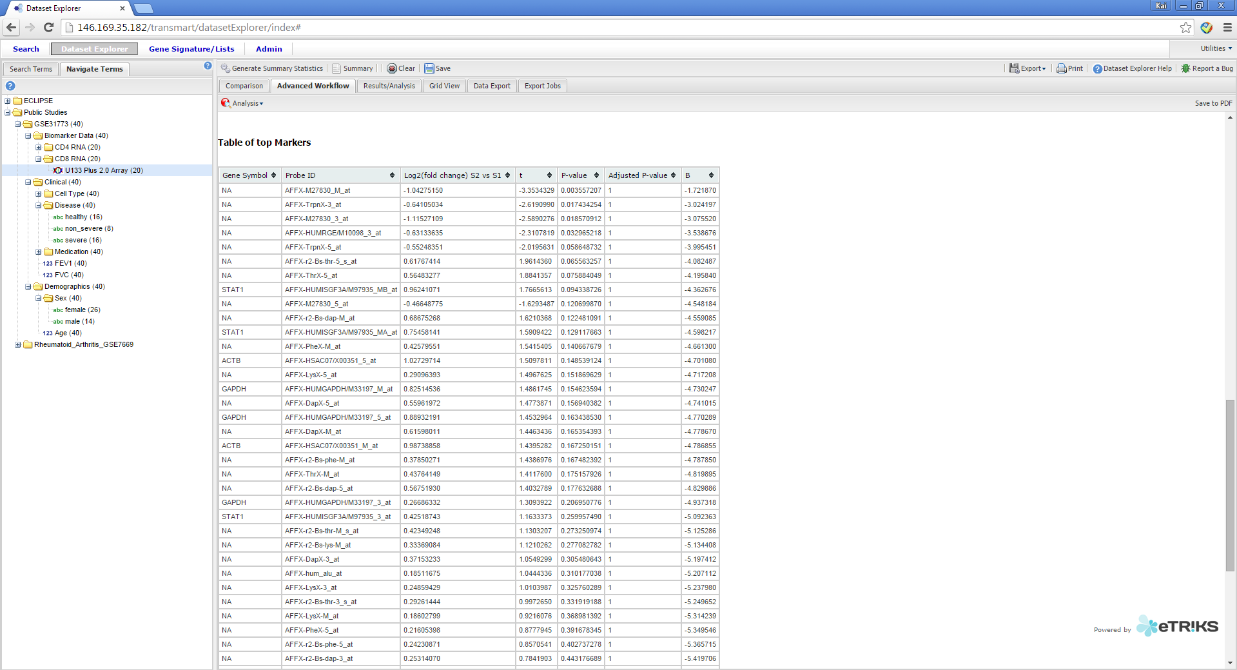
U-BIOPRED tranSMART Training
How to produce “omics” signatures
Step 13: Scroll down and view the table of results
14/01/2015
Kai Sun (kai.sun09@imperial.ac.uk)
30

Slide 31
U-BIOPRED tranSMART Training
How to…
Download an entire dataset
Download selected variables
Locate variables
Compare two groups
Produce “omics” signatures
Produce “omics” signatures for a KEGG¹ pathway
Compare the expression of a molecule in an “omic” dataset
Compare two variables
Report bugs
1. http://www.genome.jp/kegg/pathway.html
14/01/2015
Kai Sun (kai.sun09@imperial.ac.uk)
31

Slide 32
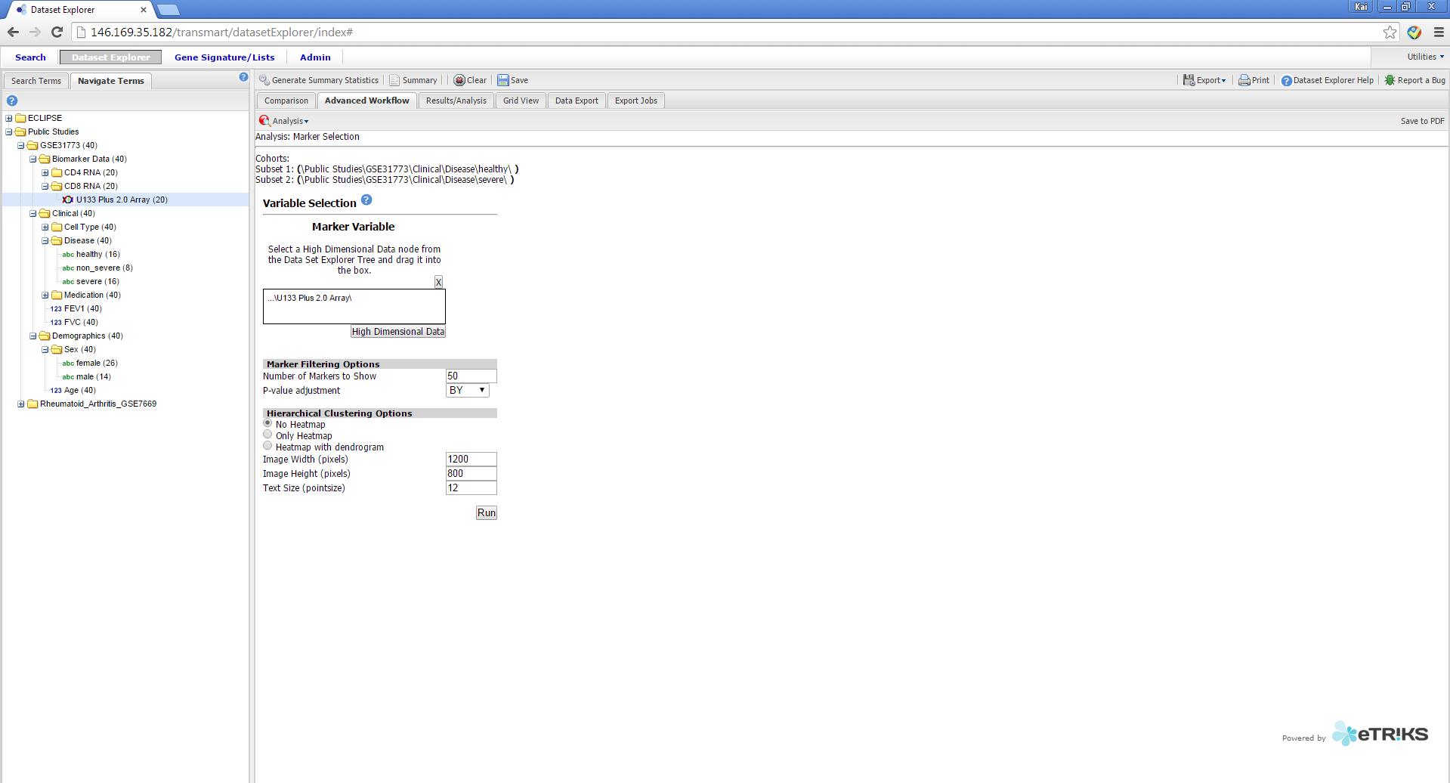
U-BIOPRED tranSMART Training
How to produce “omics” signatures for a KEGG pathway
Repeat Step 1-6 of “How to produce “omics” signatures”
14/01/2015
Kai Sun (kai.sun09@imperial.ac.uk)
32

Slide 33
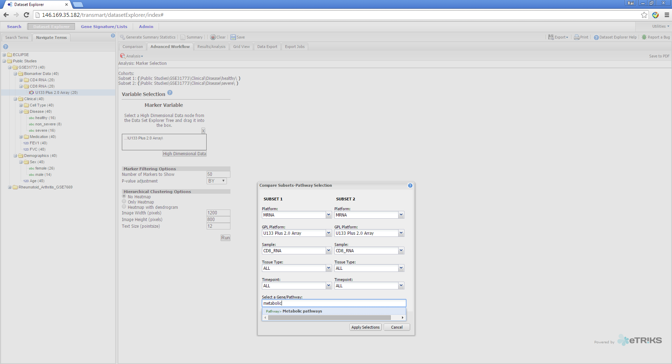
U-BIOPRED tranSMART Training
How to produce “omics” signatures for a KEGG pathway
Step 7: Type in the biological/signalling/disease pathway
You wish to assess. For a list of available pathways click here:
http://www.genome.jp/kegg/pathway.html
Step 8: Left Click “Apply Selections”
14/01/2015
Kai Sun (kai.sun09@imperial.ac.uk)
33

Slide 34
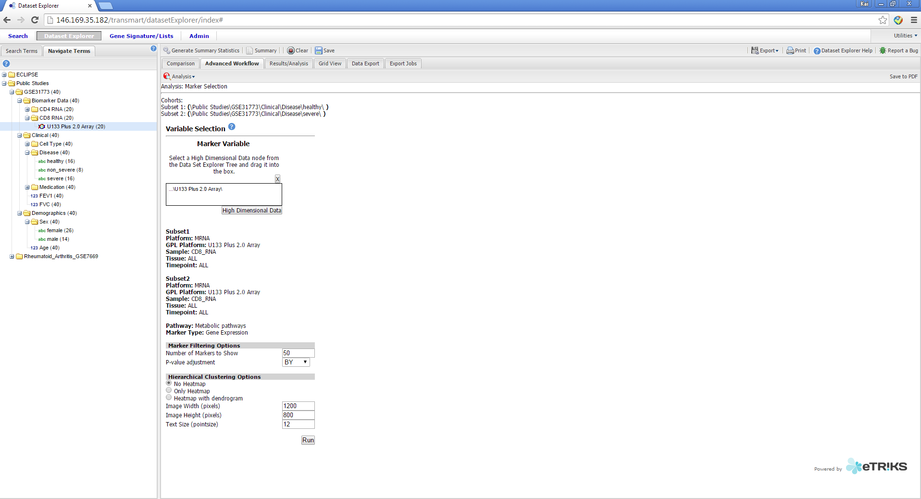
U-BIOPRED tranSMART Training
How to produce “omics” signatures for a KEGG pathway
Step 9: Select parameters (as shown previously). Notice that the pathway to be assessed has been
Registered.
Step 10: Left Click “Run”
14/01/2015
Kai Sun (kai.sun09@imperial.ac.uk)
34

Slide 35
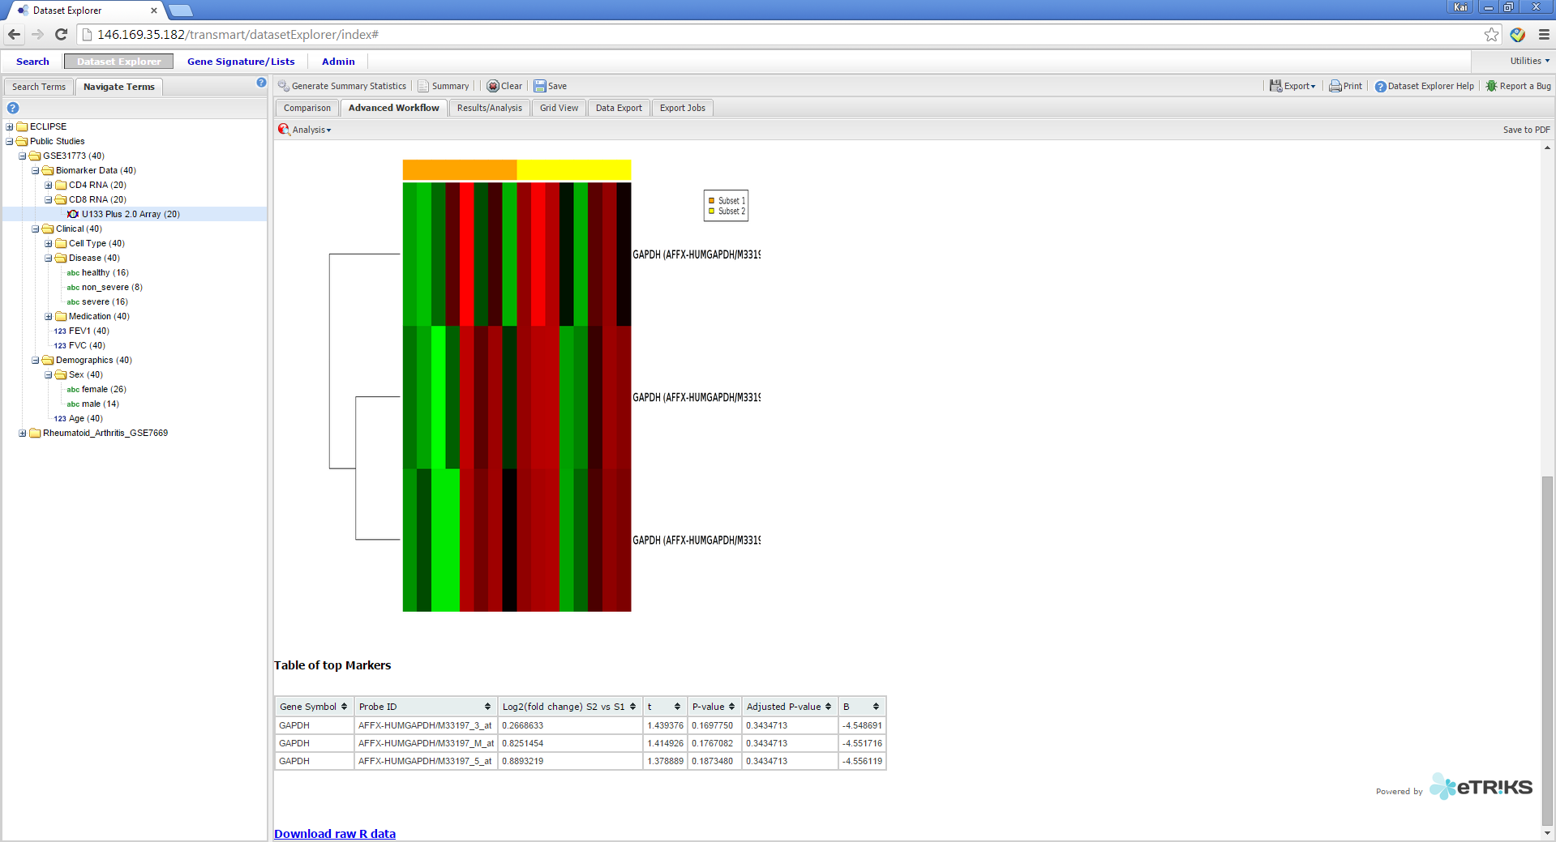
U-BIOPRED tranSMART Training
How to produce “omics” signatures for a KEGG pathway
Only gene members of the “Asthma” disease pathway
(according to KEGG classifications) are displayed
14/01/2015
Kai Sun (kai.sun09@imperial.ac.uk)
35

Slide 36
U-BIOPRED tranSMART Training
How to…
Download an entire dataset
Download selected variables
Locate variables
Compare two groups
Produce “omics” signatures
Produce “omics” signatures for a KEGG¹ pathway
Compare the expression of a molecule in an “omic” dataset
Compare two variables
Report bugs
1. http://www.genome.jp/kegg/pathway.html
14/01/2015
Kai Sun (kai.sun09@imperial.ac.uk)
36

Slide 37
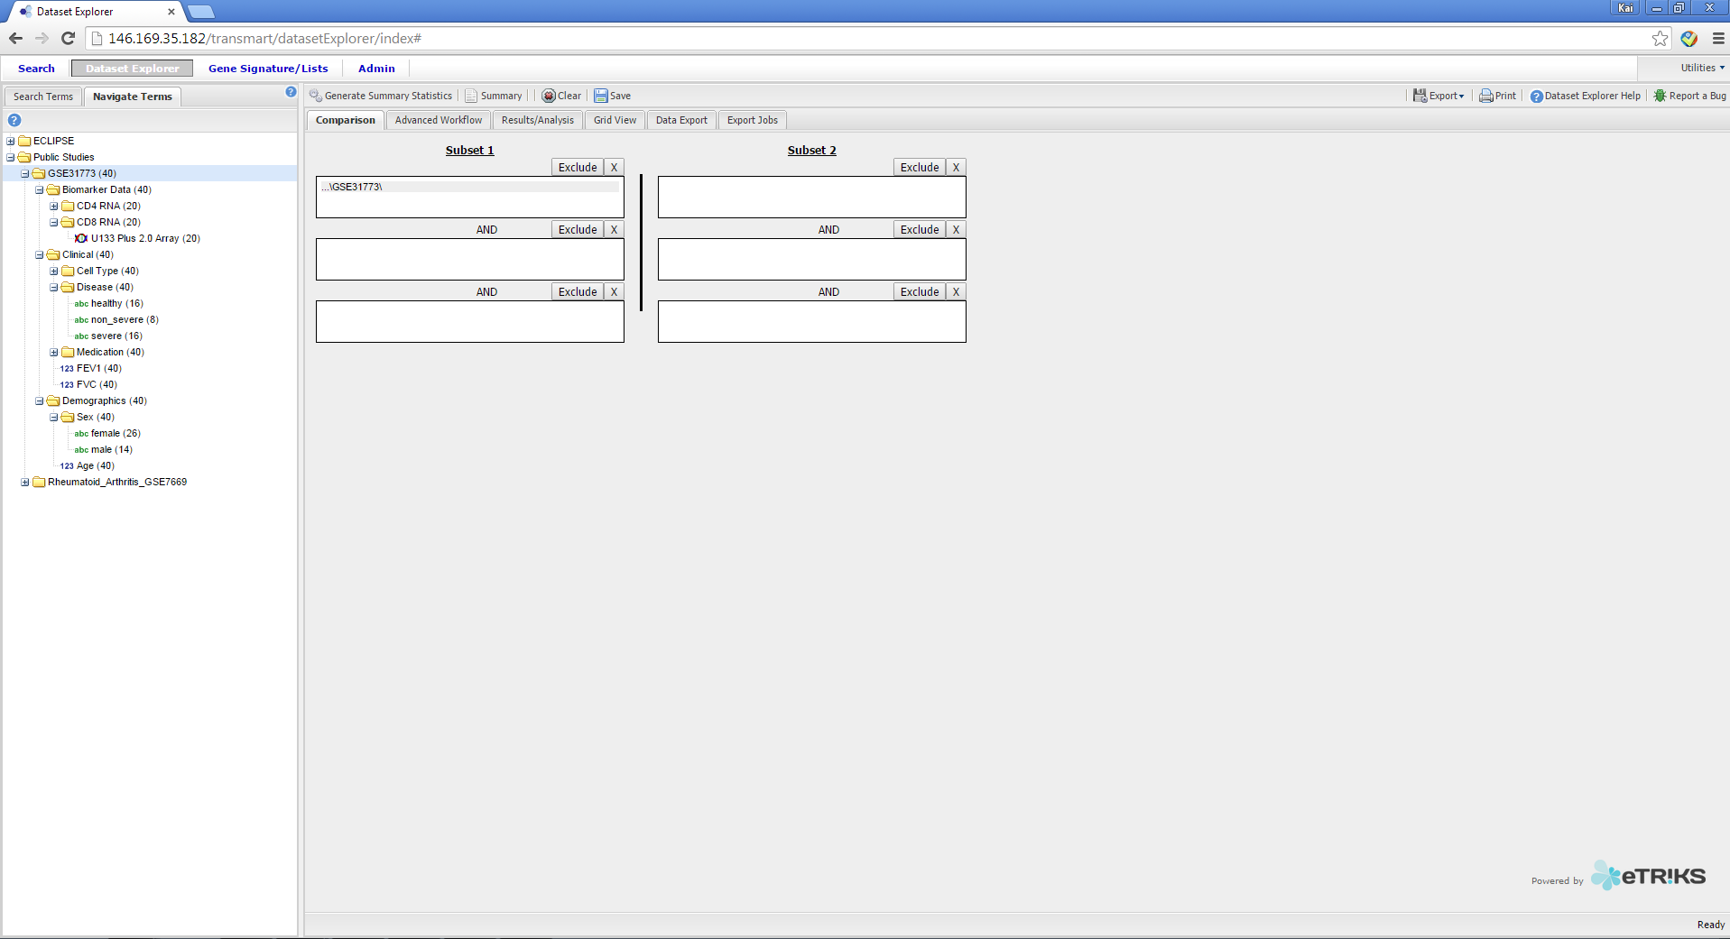
U-BIOPRED tranSMART Training
How to compare the expression of a molecule in an “omic” dataset
Step 1. Drag the study you wish to assess into “Subset 1” box
Step 2. Left Click “Advanced Workflow”
14/01/2015
Kai Sun (kai.sun09@imperial.ac.uk)
37

Slide 38
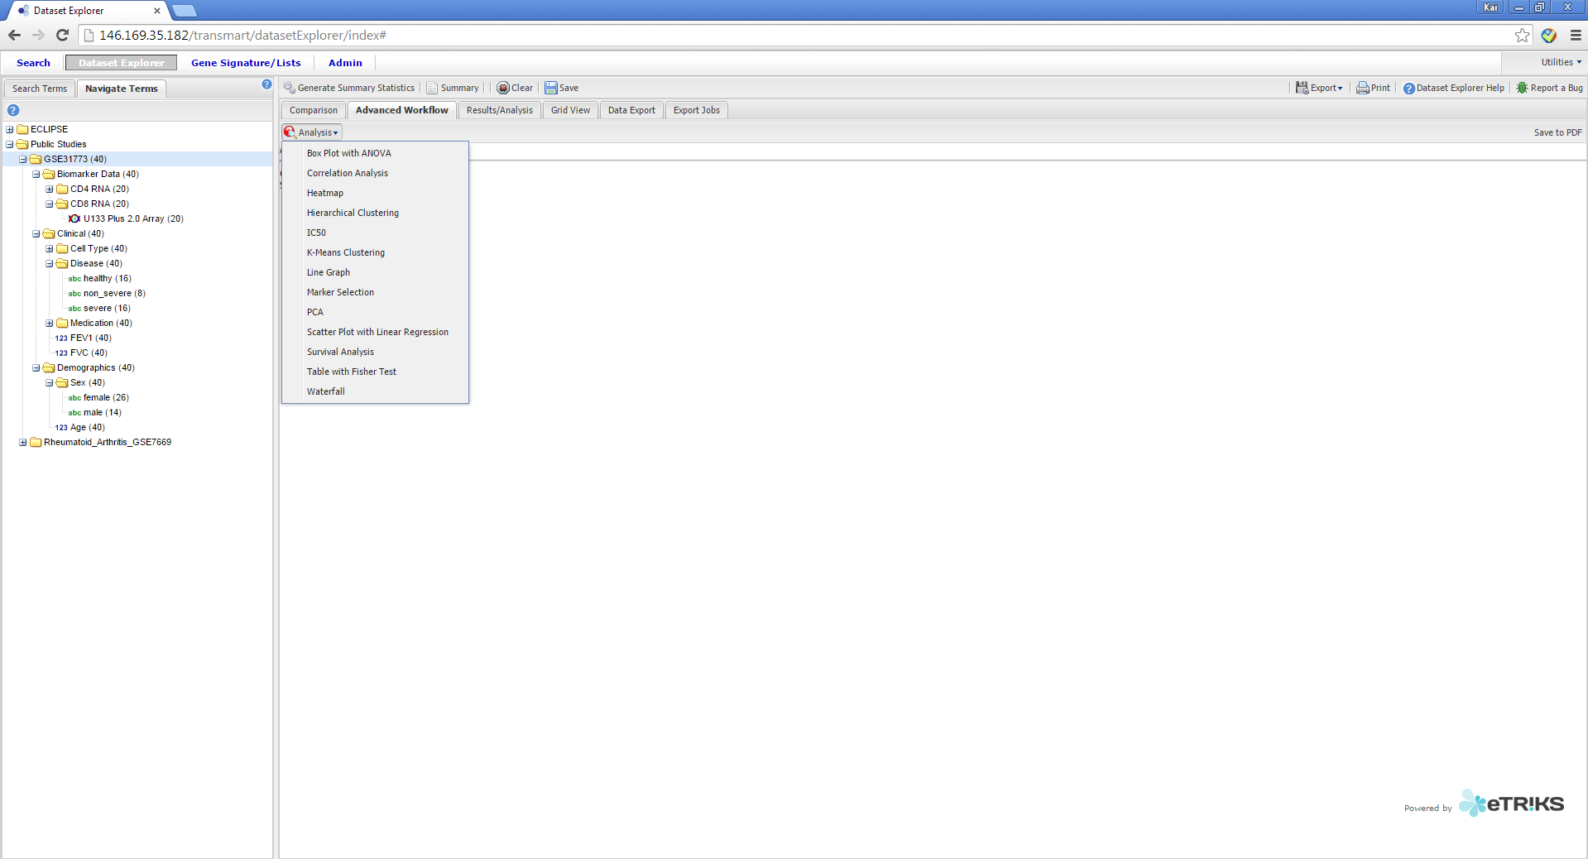
U-BIOPRED tranSMART Training
How to compare the expression of a molecule in an “omic” dataset
Step 3. Select “Analysis”
Step 4. Select the “Box Plot with ANOVA” analysis
14/01/2015
Kai Sun (kai.sun09@imperial.ac.uk)
38

Slide 39
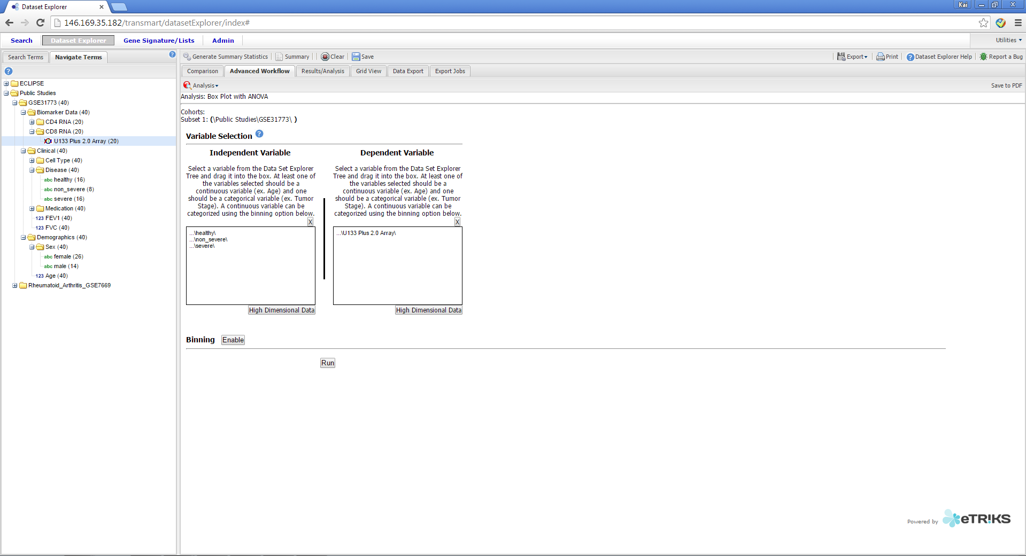
U-BIOPRED tranSMART Training
How to compare the expression of a molecule in an “omic” dataset
Step 5. Drag the groups you wish to compare into
Box 1
Step 6. Drag and Drop the Omics note (denoted by a “Double Helix Icon”) into the Marker Variable Box
Step 7: Click the High Dimensional Data Button
14/01/2015
Kai Sun (kai.sun09@imperial.ac.uk)
39

Slide 40
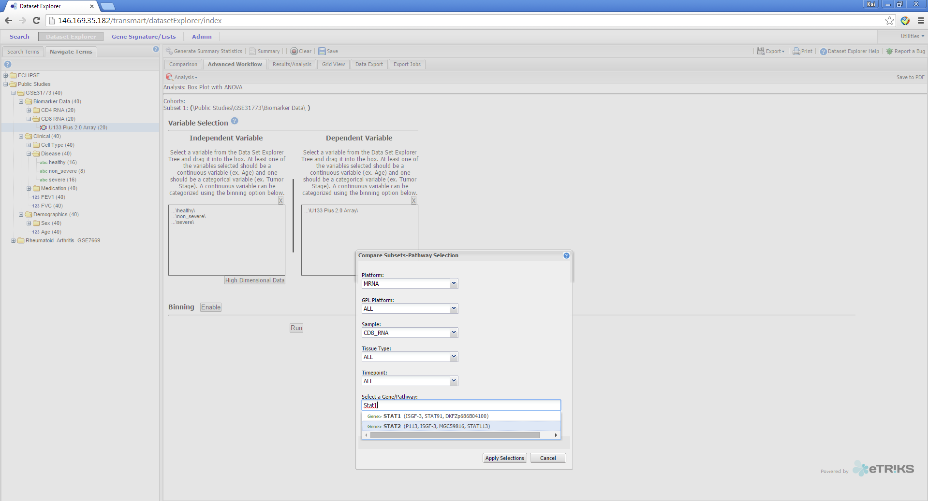
U-BIOPRED tranSMART Training
How to compare the expression of a molecule in an “omic” dataset
Step 8. Type in the name of the molecule you wish to assess in “Select a Gene/Pathway”
14/01/2015
Kai Sun (kai.sun09@imperial.ac.uk)
40

Slide 41
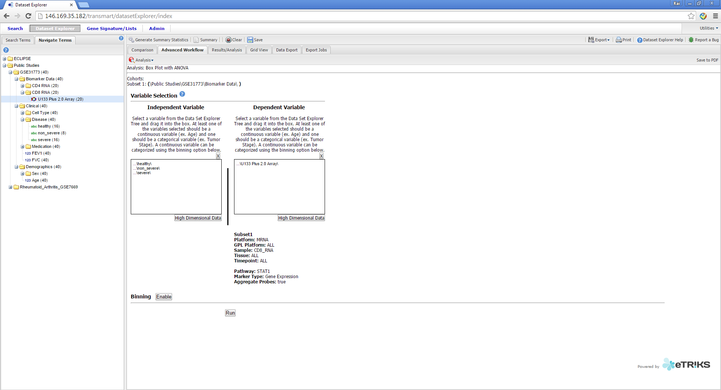
U-BIOPRED tranSMART Training
How to compare the expression of a molecule in an “omic” dataset
Step 11. “Run”
14/01/2015
Kai Sun (kai.sun09@imperial.ac.uk)
41

Slide 42
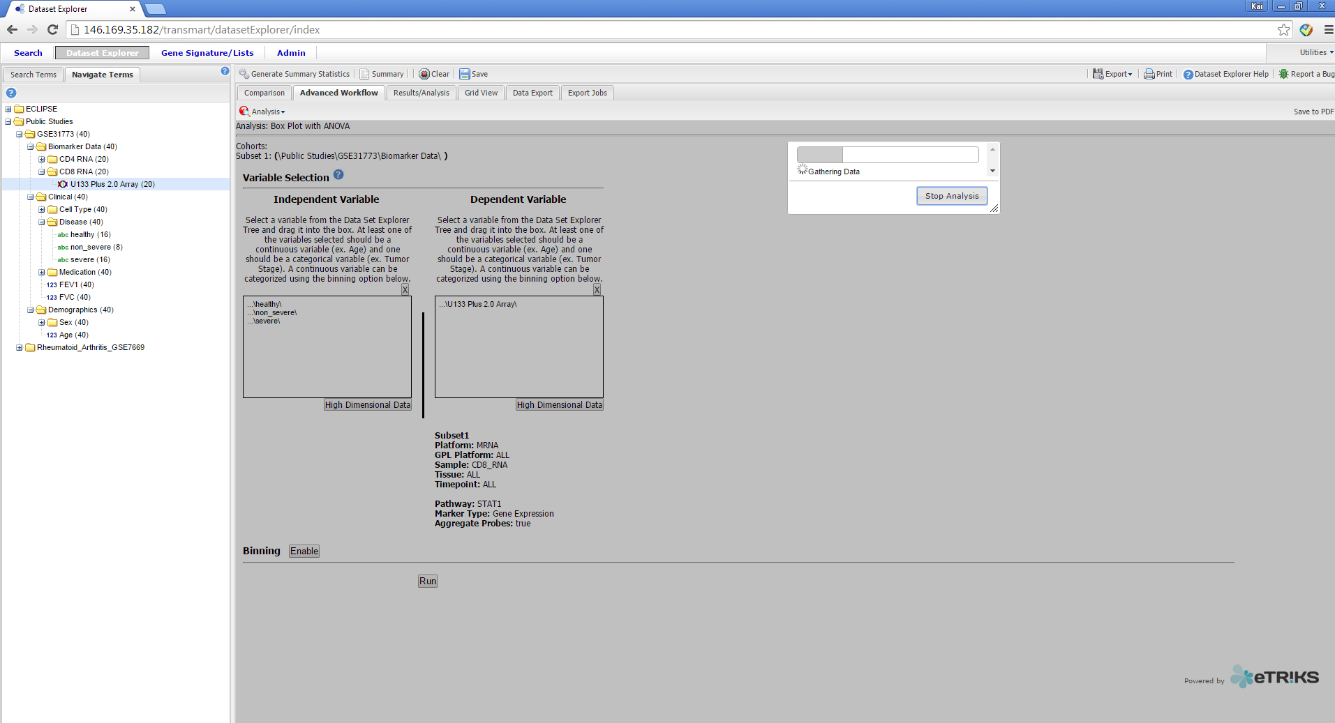
U-BIOPRED tranSMART Training
How to compare the expression of a molecule in an “omic” dataset
And wait…
14/01/2015
Kai Sun (kai.sun09@imperial.ac.uk)
42

Slide 43
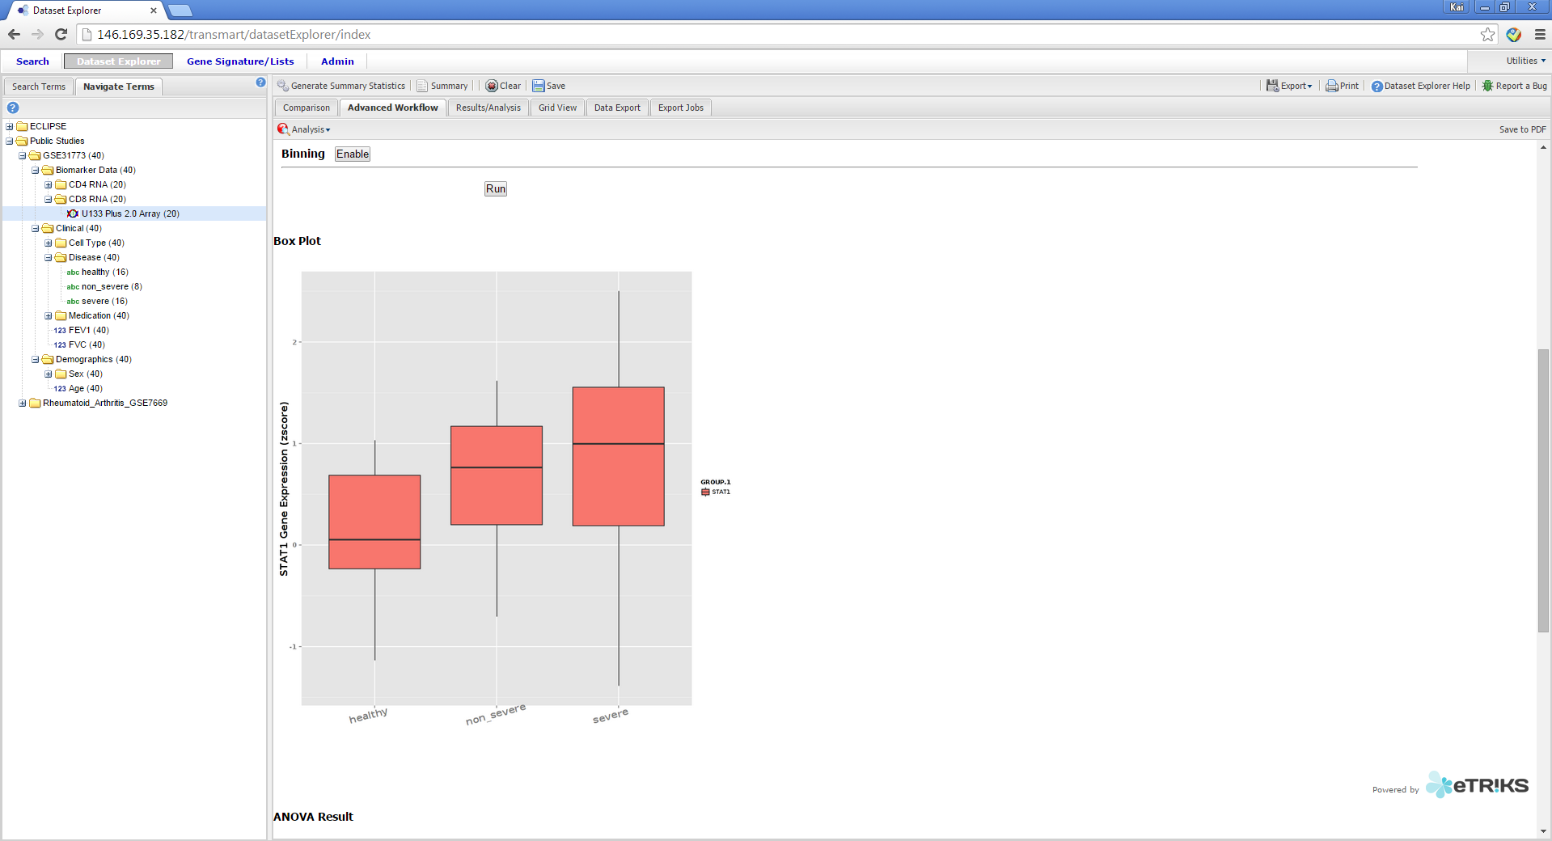
U-BIOPRED tranSMART Training
How to compare the expression of a molecule in an “omic” dataset
Step 12: Scroll down and view the Box Plot
14/01/2015
Kai Sun (kai.sun09@imperial.ac.uk)
43

Slide 44
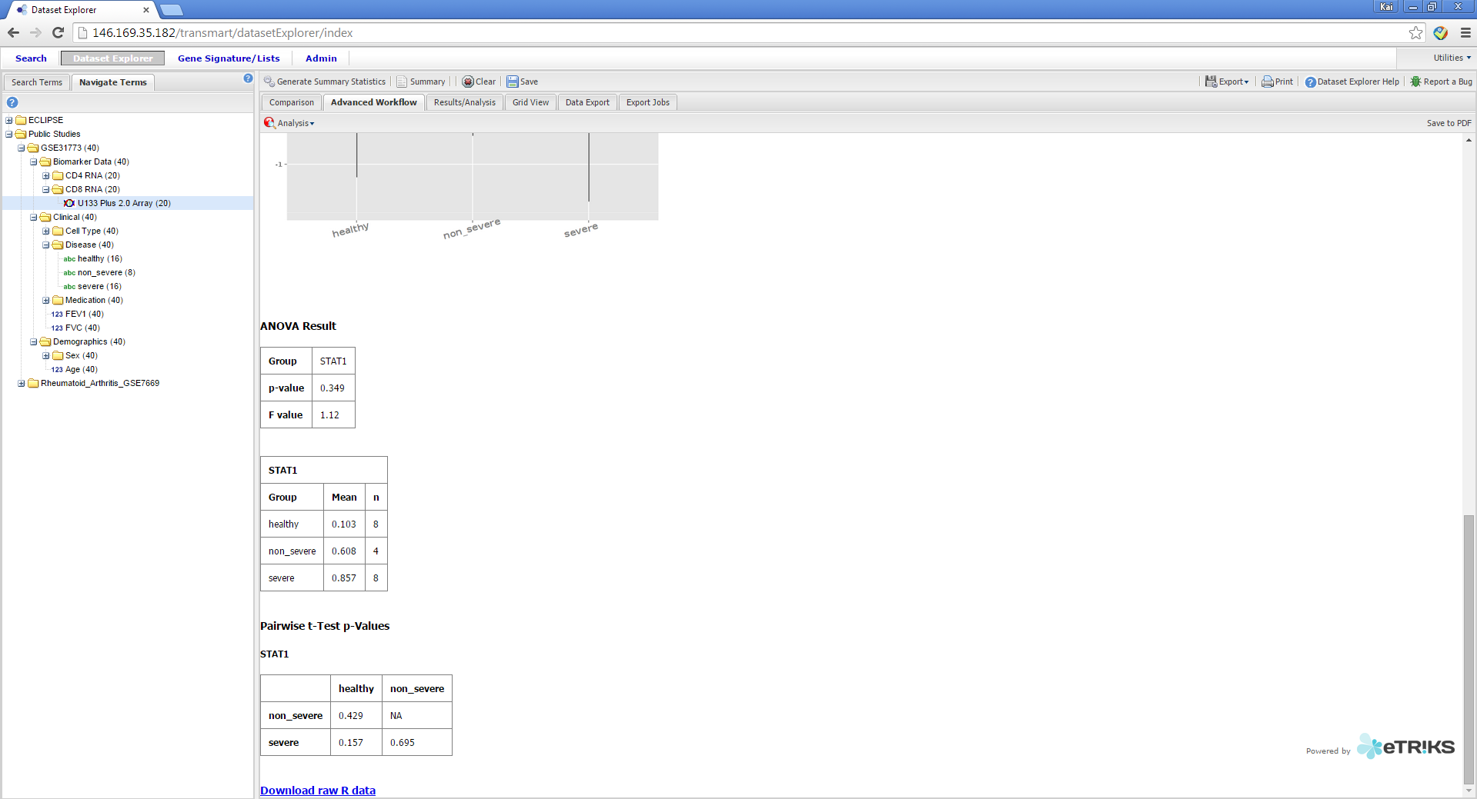
U-BIOPRED tranSMART Training
How to compare the expression of a molecule in an “omic” dataset
Step 13: Scroll down and view ANOVA results
14/01/2015
Kai Sun (kai.sun09@imperial.ac.uk)
44

Slide 45
U-BIOPRED tranSMART Training
How to…
Download an entire dataset
Download selected variables
Locate variables
Compare two groups
Produce “omics” signatures
Produce “omics” signatures for a KEGG1 pathway
Compare the expression of a molecule in an “omic” dataset
Compare two variables
Report bugs
1. http://www.genome.jp/kegg/pathway.html
14/01/2015
Kai Sun (kai.sun09@imperial.ac.uk)
45

Slide 46
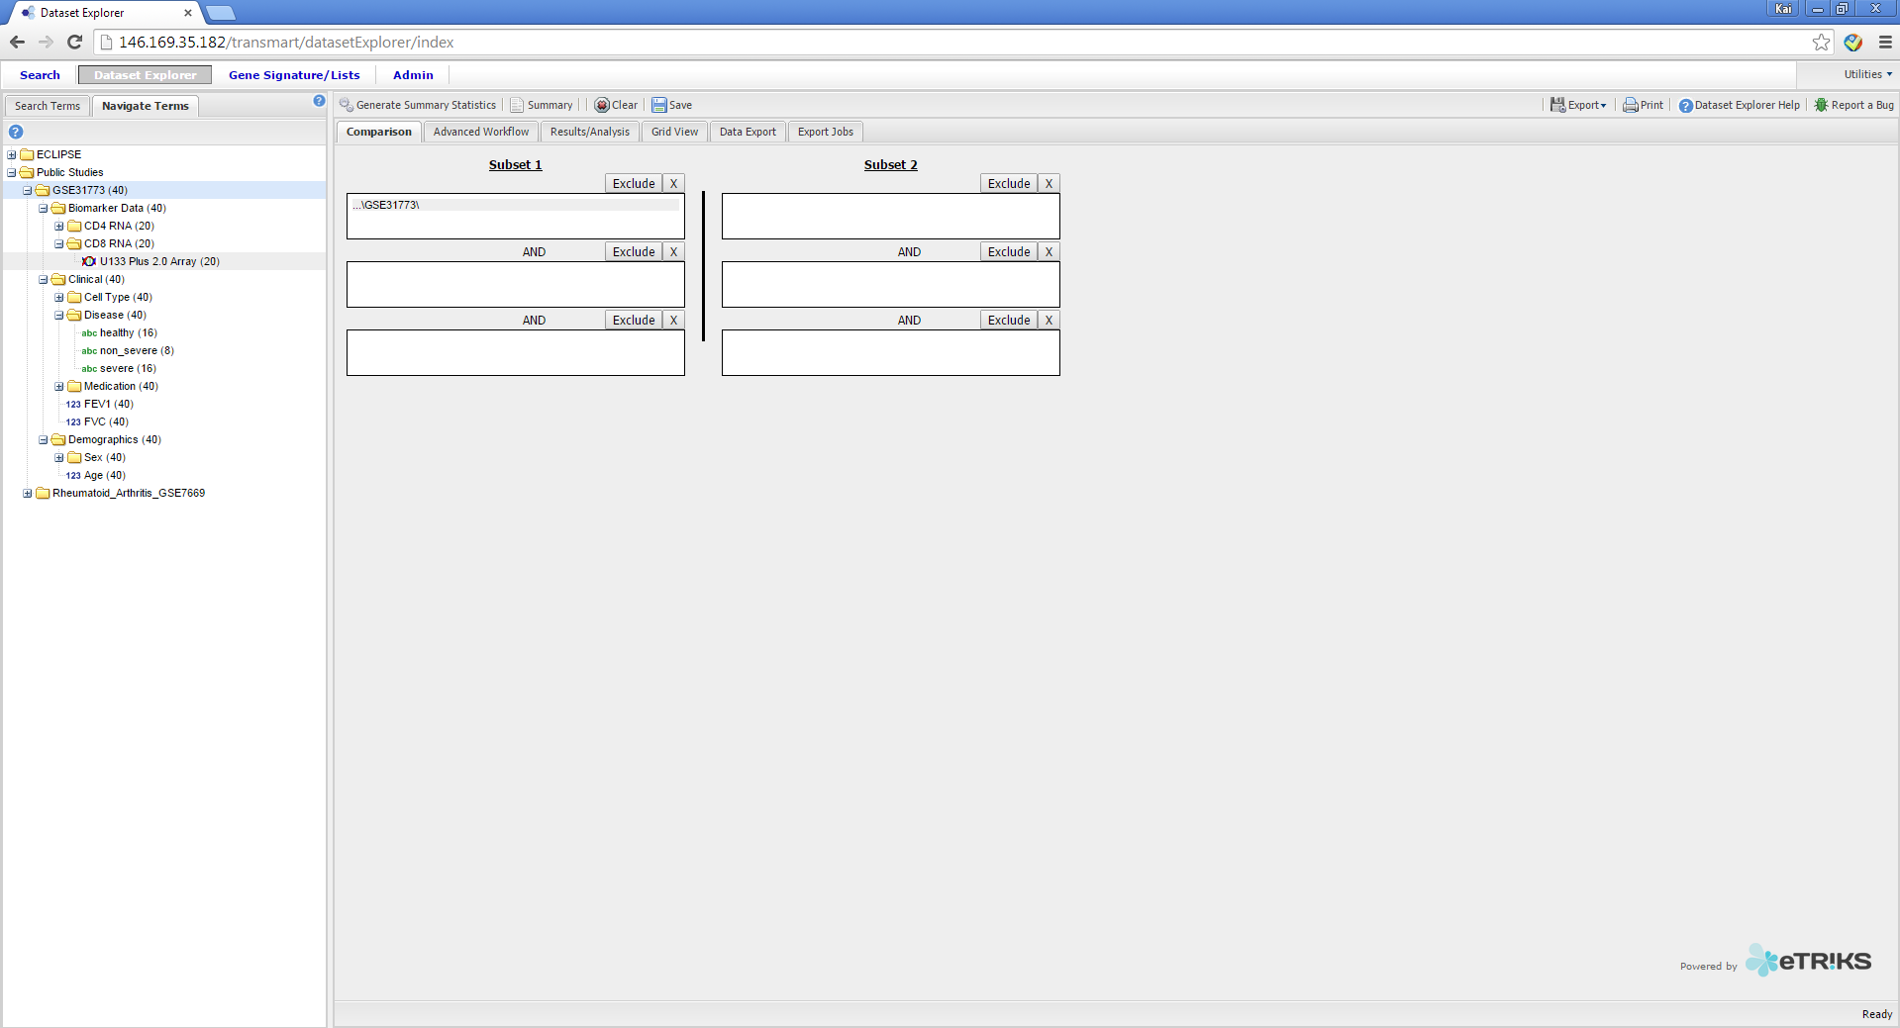
U-BIOPRED tranSMART Training
How to compare two variables
Step 1. Drag the study you wish to assess into “Subset 1” box
Step 2. Left Click “Advanced Workflow”
14/01/2015
Kai Sun (kai.sun09@imperial.ac.uk)
46

Slide 47
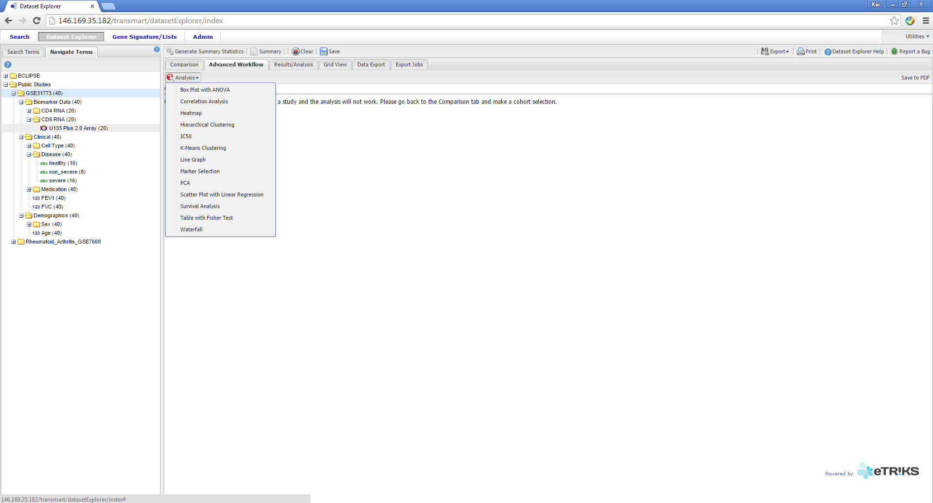
U-BIOPRED tranSMART Training
How to compare two variables
Step 3. Select the “Correlation Analysis” analysis
14/01/2015
Kai Sun (kai.sun09@imperial.ac.uk)
47

Slide 48
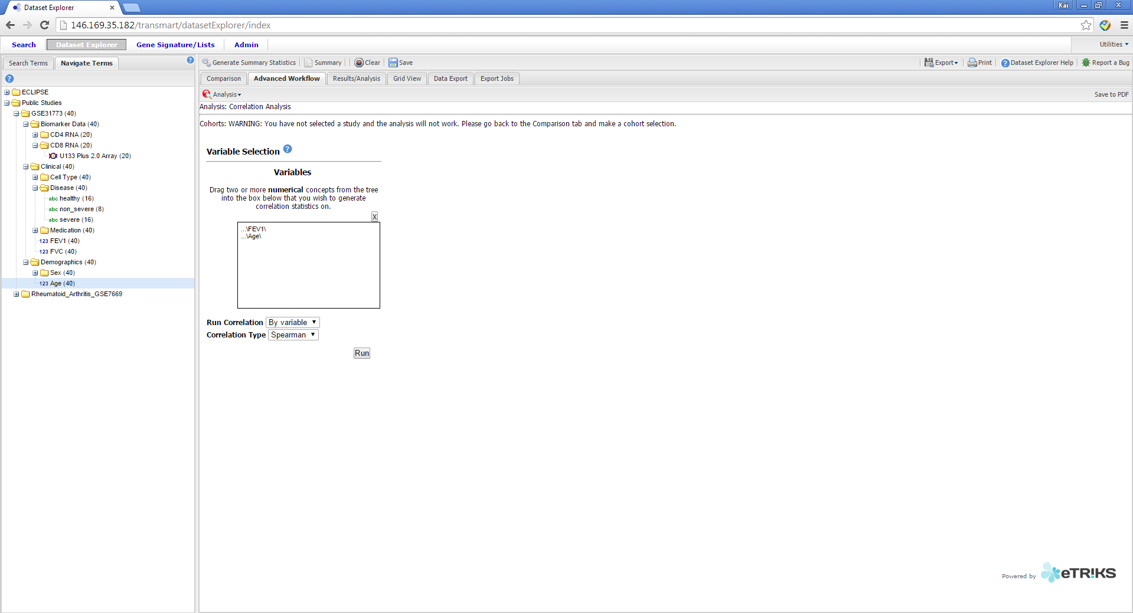
U-BIOPRED tranSMART Training
How to compare two variables
Step 4. Drag the variables you wish to compare into the box
Step 5. Select the parameters. Correlation type:
Spearman
Pearson
Kendall
Step 6. Run
14/01/2015
Kai Sun (kai.sun09@imperial.ac.uk)
48

Slide 49
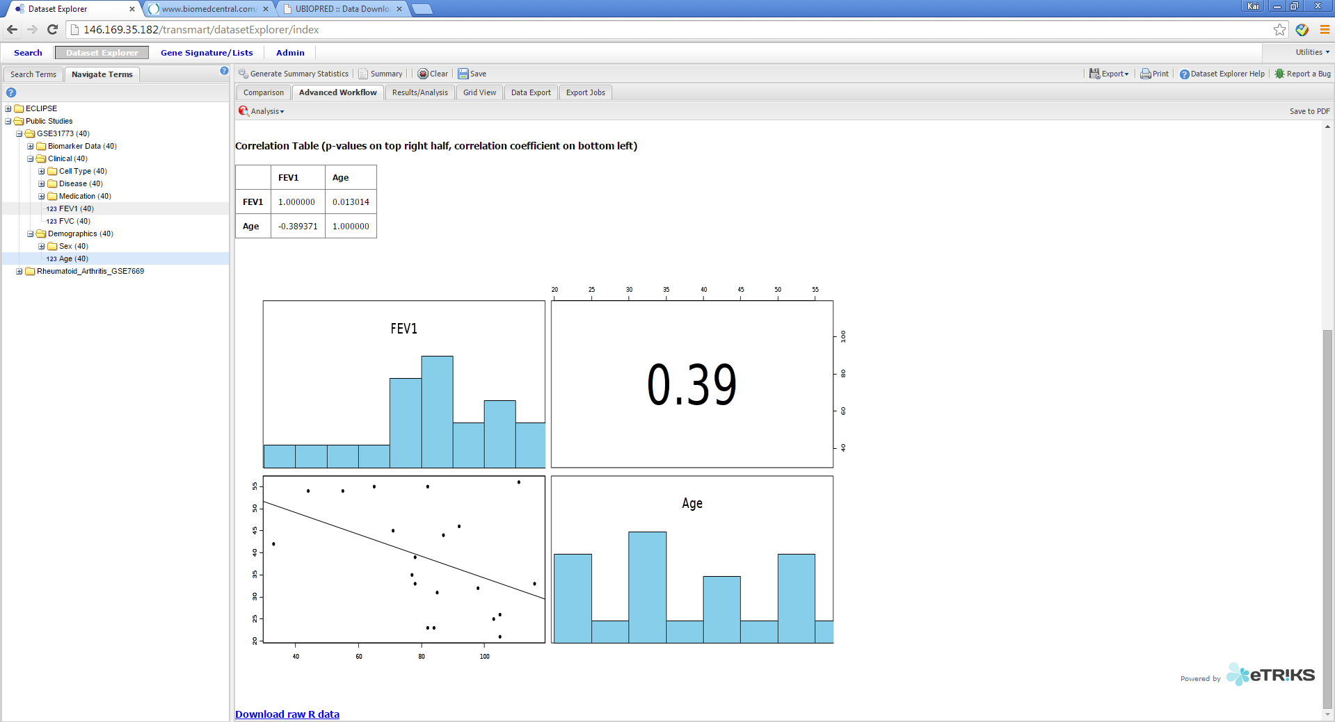
U-BIOPRED tranSMART Training
How to compare two variables
Step 7: Scroll down and view the correlation analysis results
14/01/2015
Kai Sun (kai.sun09@imperial.ac.uk)
49

Slide 50
U-BIOPRED tranSMART Training
How to…
Download an entire dataset
Download selected variables
Locate variables
Compare two groups
Produce “omics” signatures
Produce “omics” signatures for a KEGG1 pathway
Compare the expression of a molecule in an “omic” dataset
Compare the expression of a biological pathway in an “omic” dataset
Compare two variables
Report bugs
1. http://www.genome.jp/kegg/pathway.html
14/01/2015
Kai Sun (kai.sun09@imperial.ac.uk)
50

Slide 51
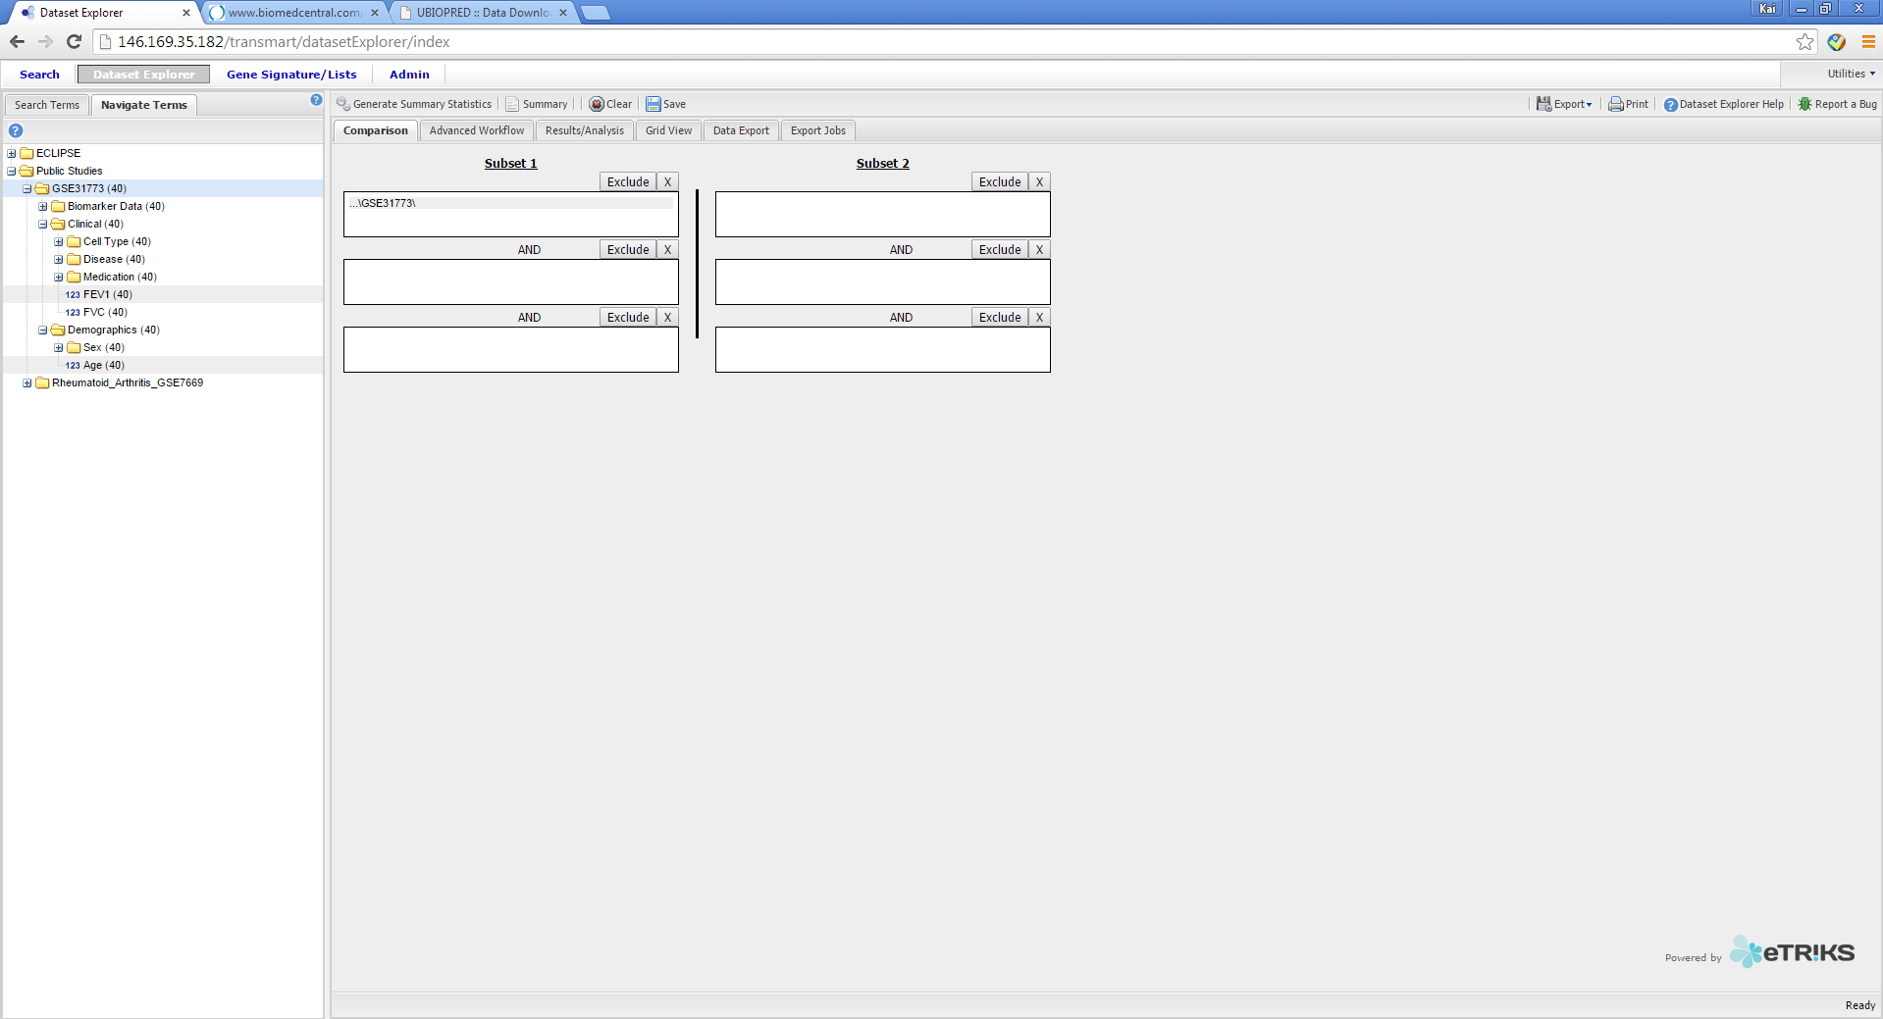
U-BIOPRED tranSMART Training
How to report bugs and request future features
Step1: Click the “Report a Bug” button if you encounter a problem or wish to request a feature
14/01/2015
Kai Sun (kai.sun09@imperial.ac.uk)
51

Slide 52
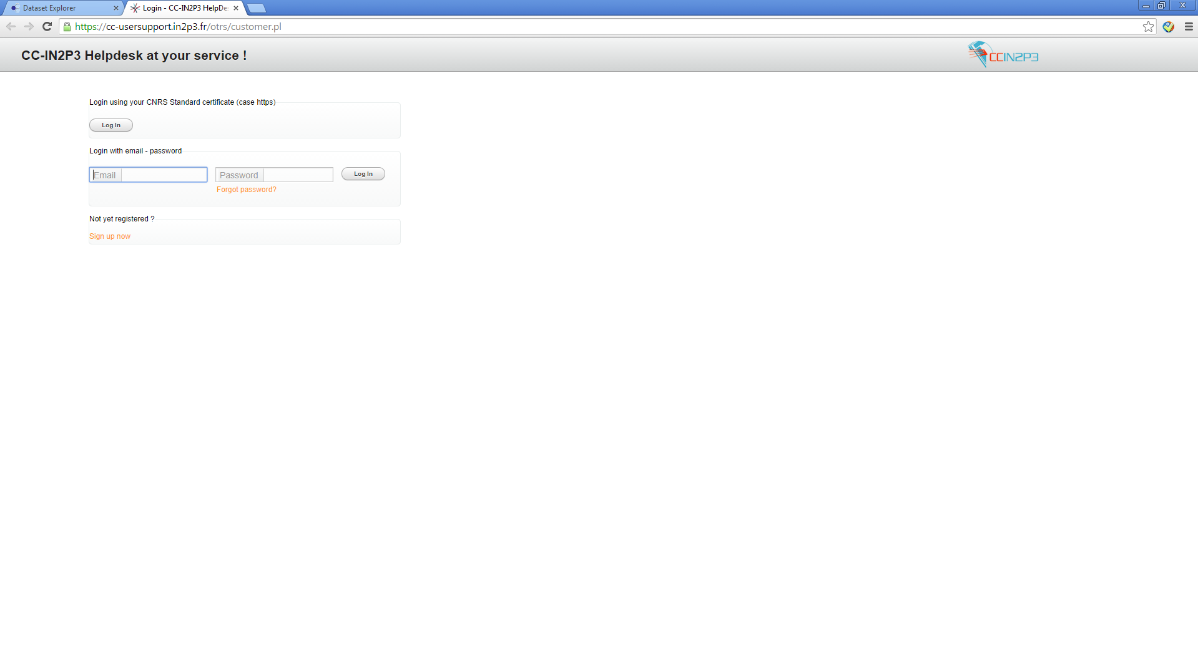
U-BIOPRED tranSMART Training
How to report bugs and request future features
Step 2: Sign-in (if you already have an account) or register
14/01/2015
Kai Sun (kai.sun09@imperial.ac.uk)
52

Slide 53
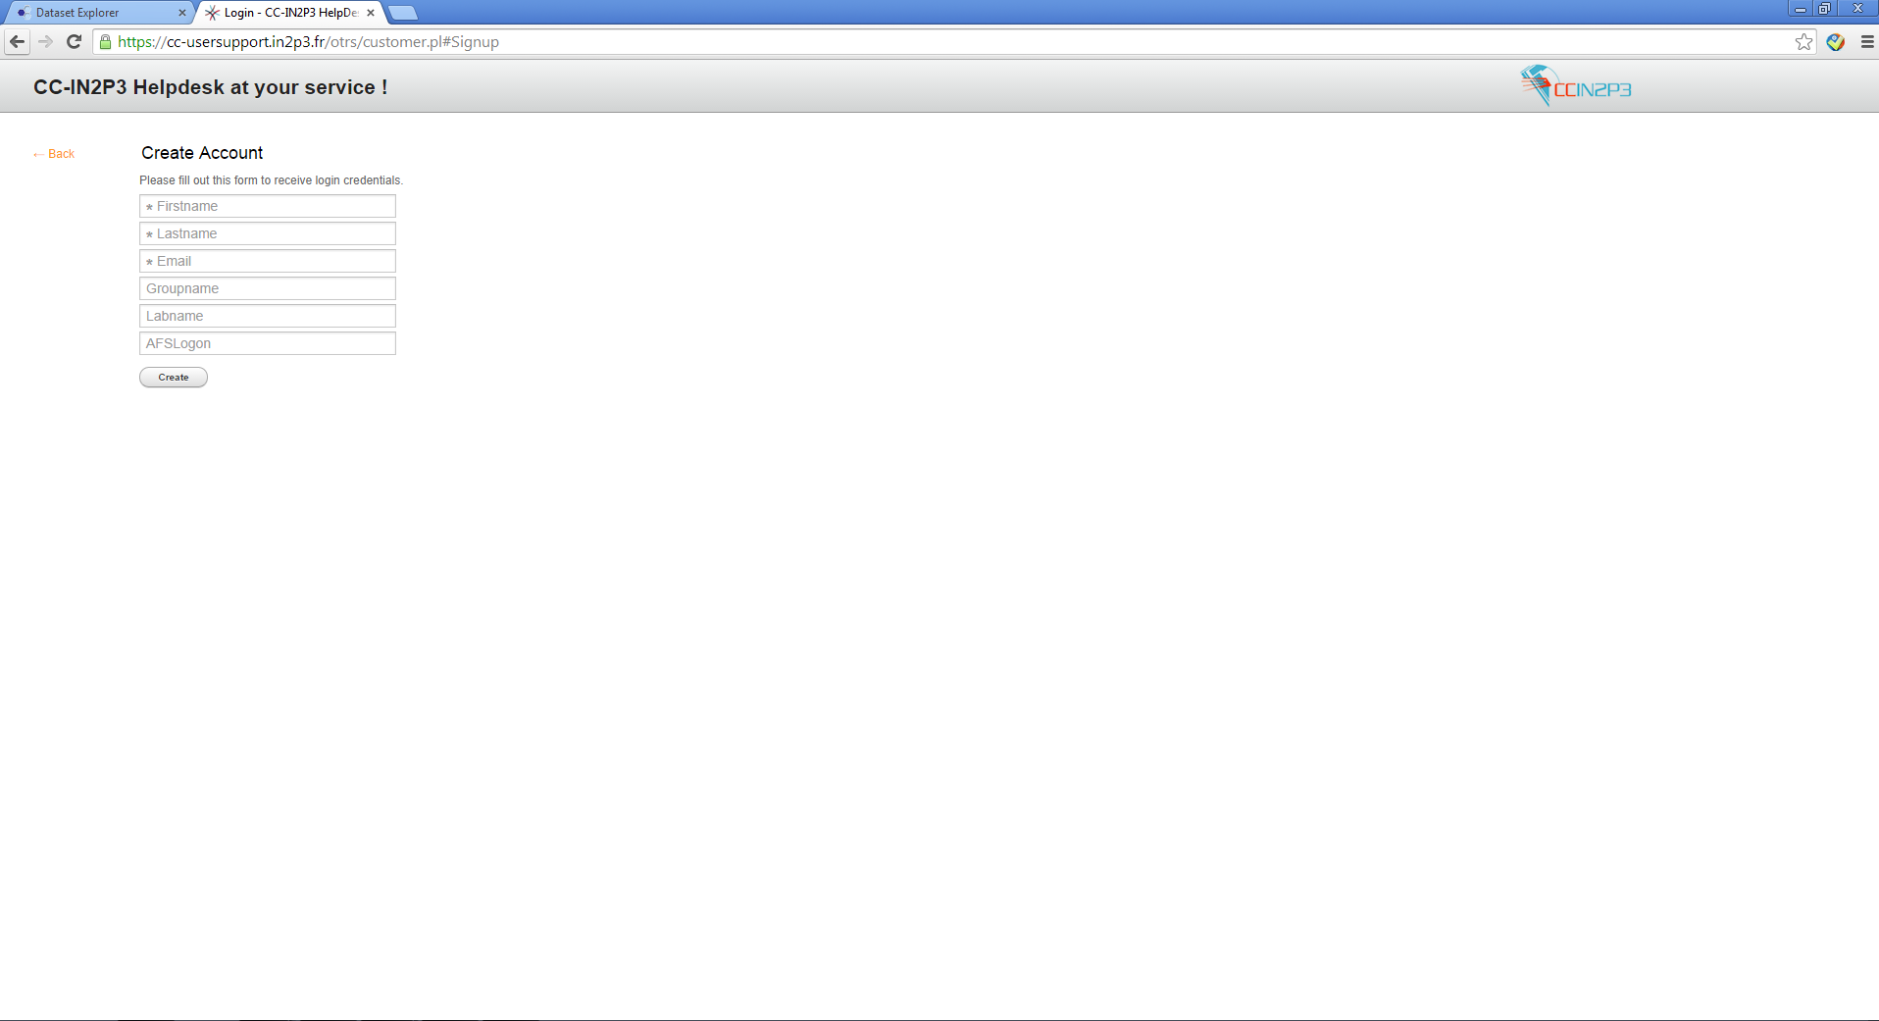
U-BIOPRED tranSMART Training
How to report bugs and request future features
Create an account, only these fields are necessary
14/01/2015
Kai Sun (kai.sun09@imperial.ac.uk)
53

Slide 54
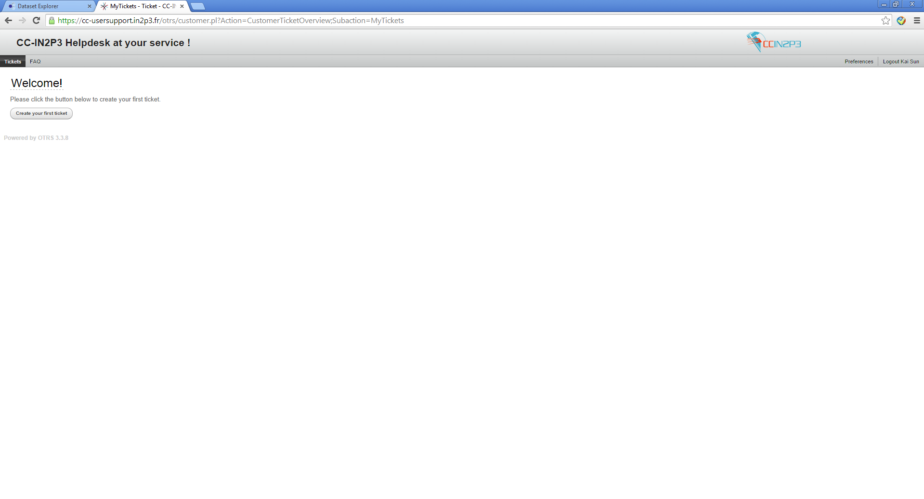
U-BIOPRED tranSMART Training
How to report bugs and request future features
Step 3: Create a ticket
14/01/2015
Kai Sun (kai.sun09@imperial.ac.uk)
54

Slide 55
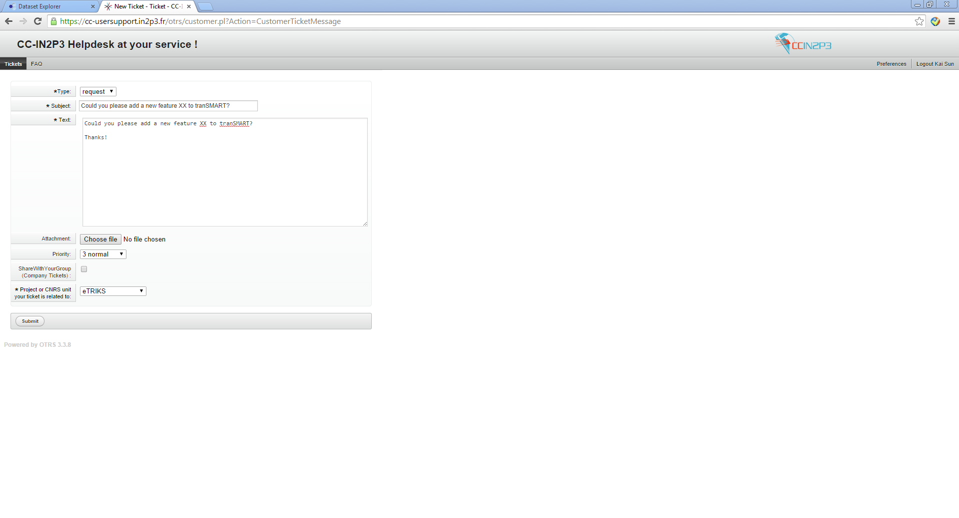
U-BIOPRED tranSMART Training
How to report bugs and request future features
Step 4: Fill the form
Please state whether you are reporting an Incident (problem you came across) or a Request (request for additional functionality).
Please enter:
1) the subject
2) the address of the tranSMART platform you are using
3) a description of the incident or request
4) relevant documents such as screenshots
Please click submit and an eTRIKS representative will contact you ASAP
Disclaimer: Please HIDE (blank-out) any sensitive project specific information, such as patient IDs or specific measurement results, to ensure confidentiality in not breached.
14/01/2015
Kai Sun (kai.sun09@imperial.ac.uk)
55

